Slide 1
Lecture 5: Linear Regression

Slide 2
ANNOUNCEMENTS
Advanced Sections (A-Sections):
TODAY @ 4:30pm (MD G115)
Linear Algebra and Hypothesis Testing, Pavlos + Kevin
ED-Exercises grading:
All exercises together are equivalent to one question for that day’s quiz.
We grade for accuracy. You will receive full grade even if it fails the finicky test.
We will grade these exercises very leniently.

Slide 3

Summary from last lecture

Slide 4
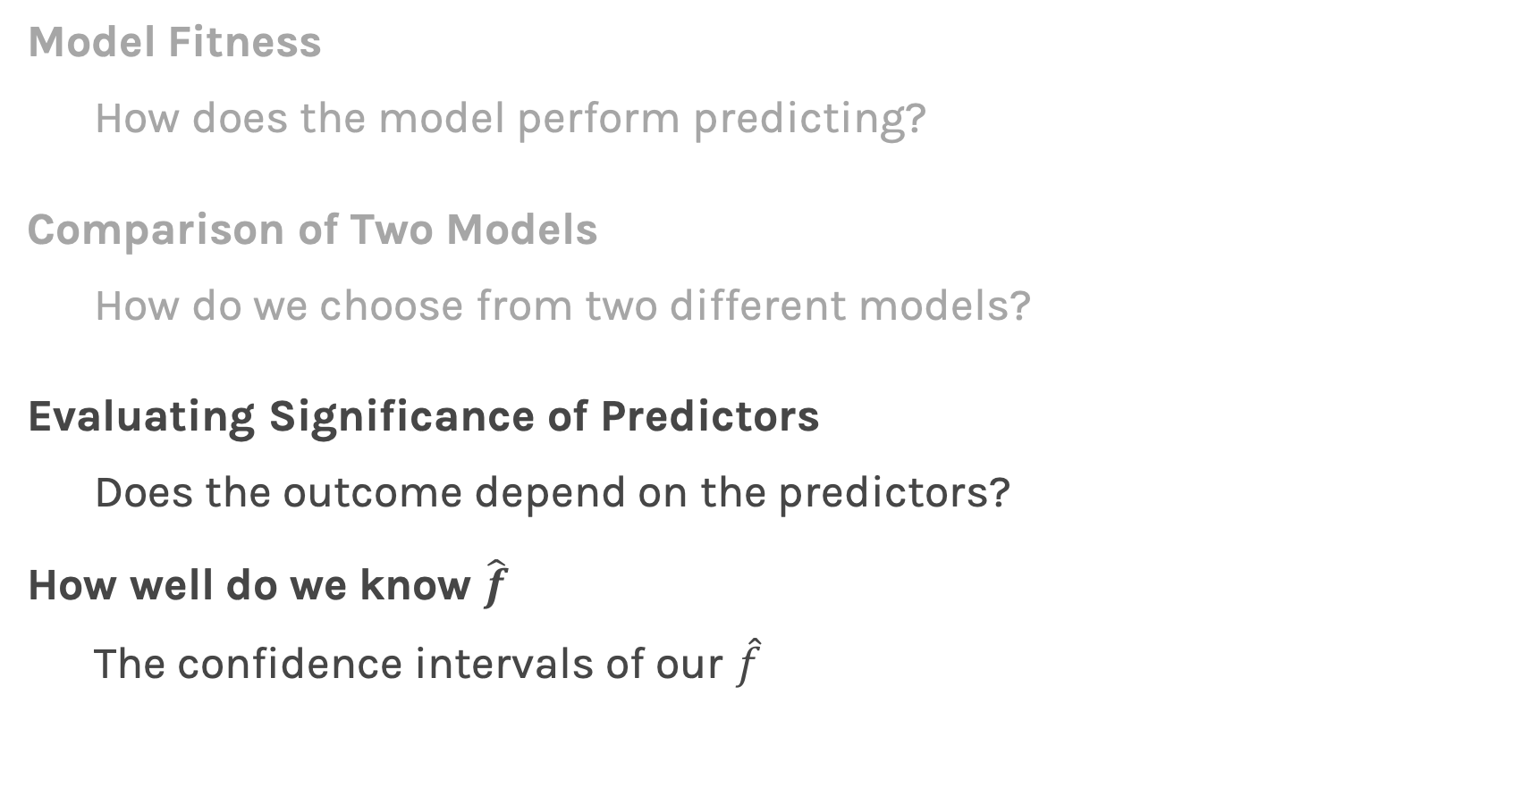
Summary from last lecture
Model Fitness
How does the model perform predicting?
Comparison of Two Models
How do we choose from two different models?
Evaluating Significance of Predictors
Does the outcome depend on the predictors?
How well do we know $\hat{f}$
The confidence intervals of our $\hat{f}$
This lecture

Slide 5
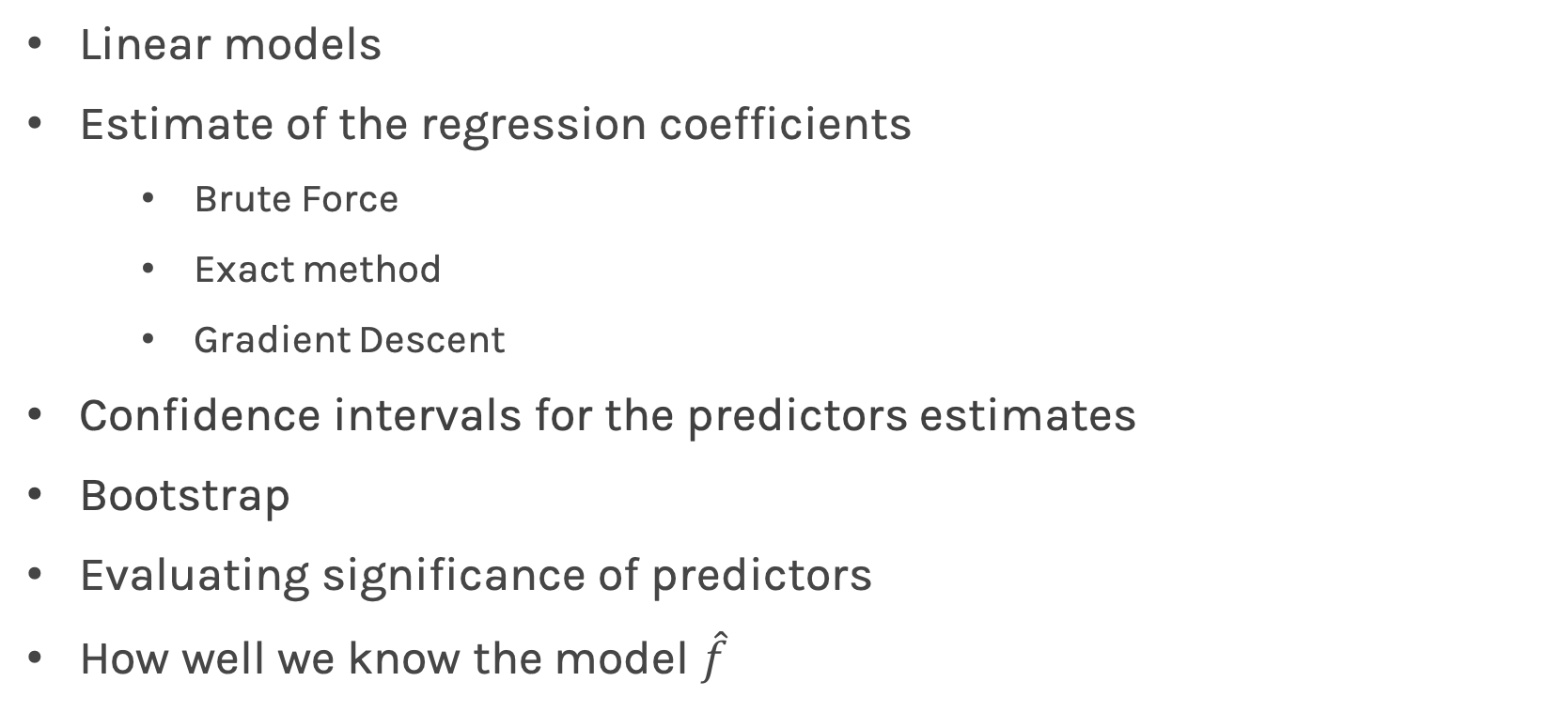
Lecture Outline
Linear models
Estimate of the regression coefficients
Brute Force
Exact method
Gradient Descent
Confidence intervals for the predictors estimates
Bootstrap
Evaluating significance of predictors
How well we know the model $\hat{f}$

Slide 6
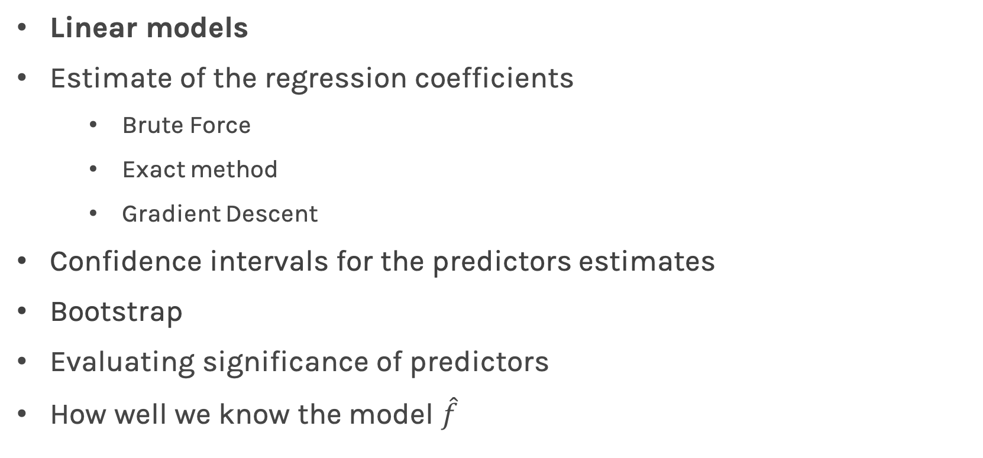
Lecture Outline
Linear models
Estimate of the regression coefficients
Brute Force
Exact method
Gradient Descent
Confidence intervals for the predictors estimates
Bootstrap
Evaluating significance of predictors
How well we know the model $\hat{f}$

Slide 7
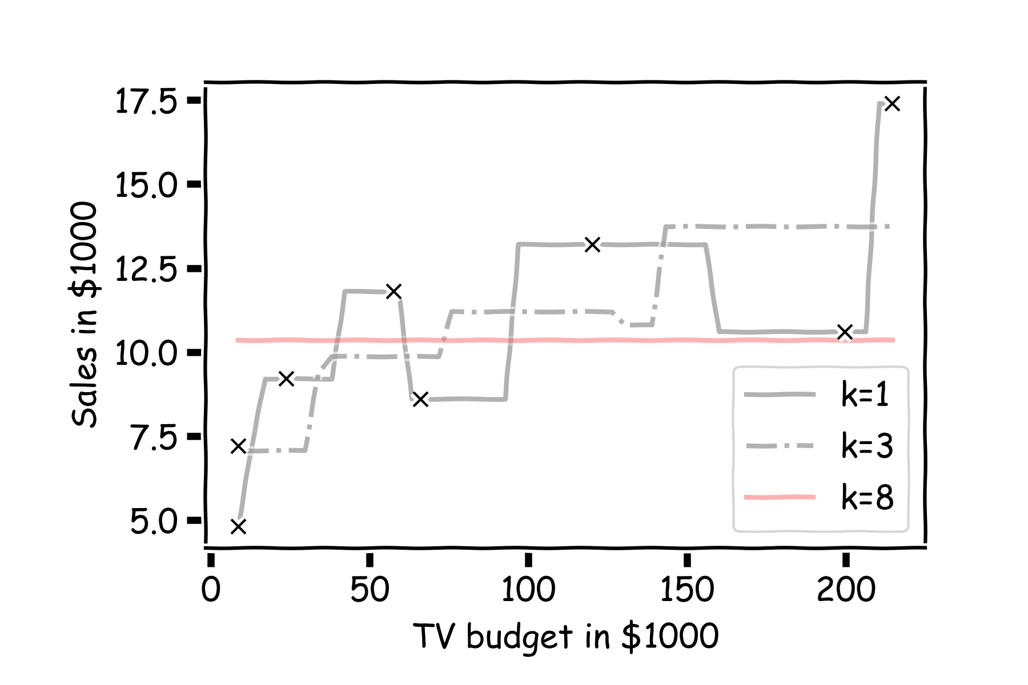
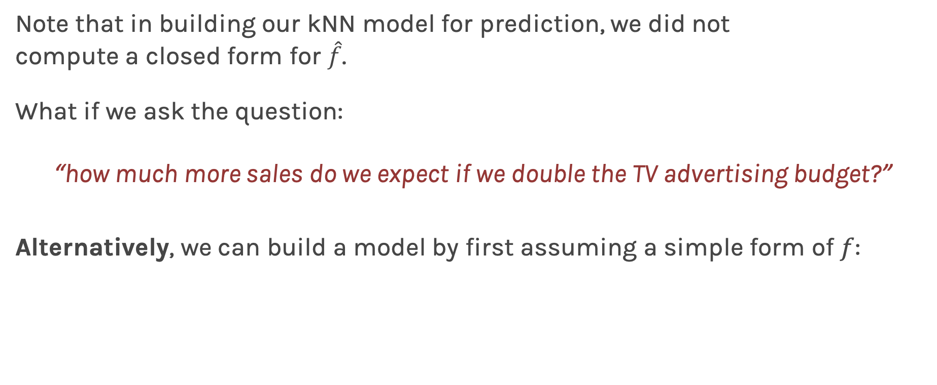
Linear Models
Note that in building our kNN model for prediction, we did not compute a closed form for $\hat{f}$.
What if we ask the question:
“how much more sales do we expect if we double the TV advertising budget?”
Alternatively, we can build a model by first assuming a simple form of $f$:

Slide 8
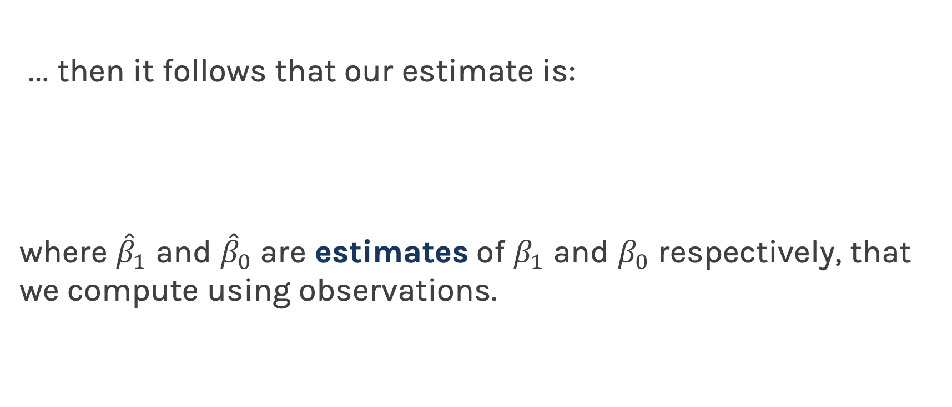
Linear Regression
… then it follows that our estimate is:
where ${\hat{β}}_{1}$ and ${\hat{β}}_{0}$are estimates of $β_{1}$ and $β_{0}$ respectively, that we compute using observations.

Slide 9
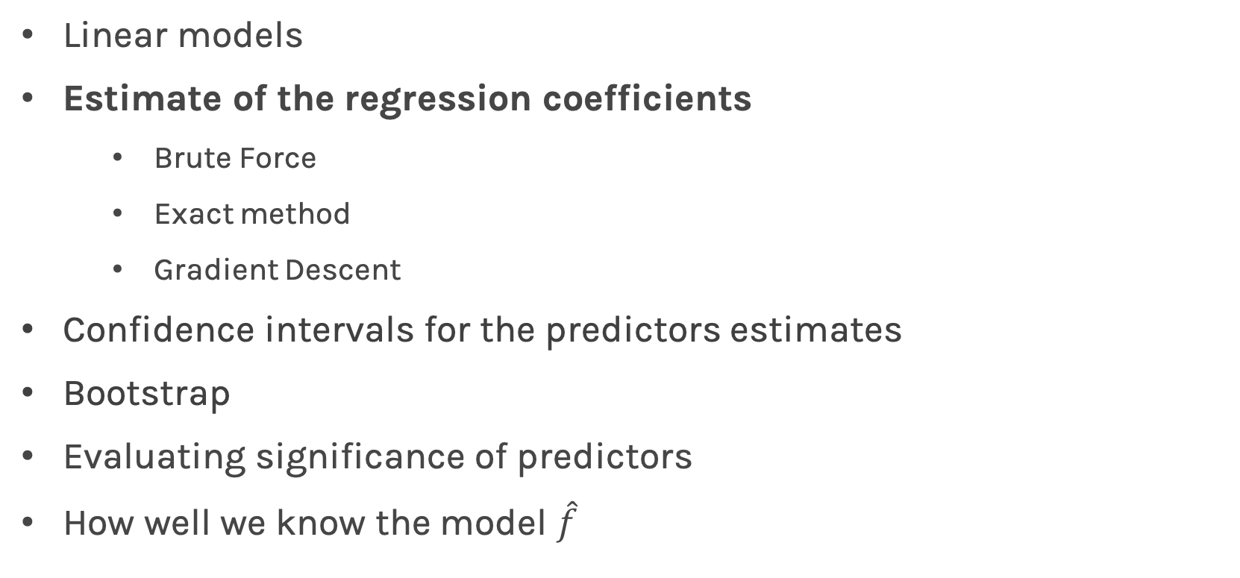
Lecture Outline
Linear models
Estimate of the regression coefficients
Brute Force
Exact method
Gradient Descent
Confidence intervals for the predictors estimates
Bootstrap
Evaluating significance of predictors
How well we know the model $\hat{f}$

Slide 10
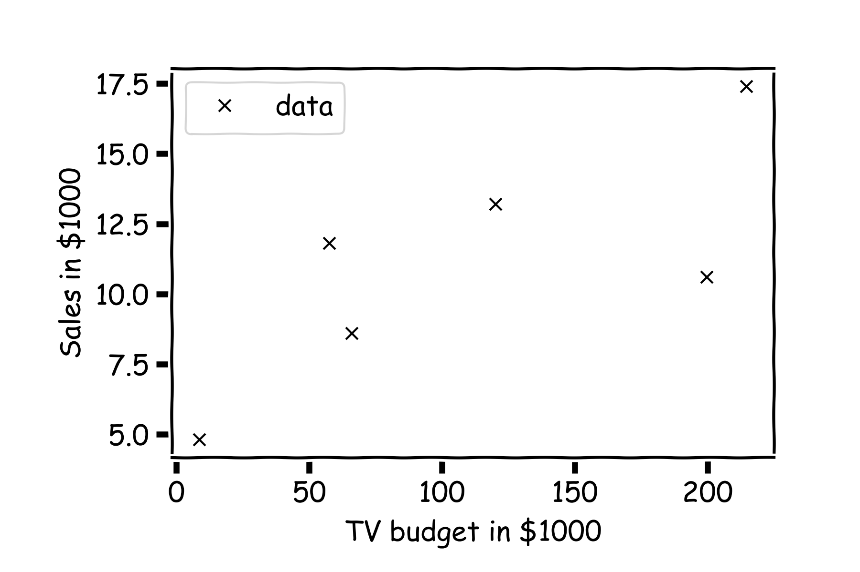
Estimate of the regression coefficients
For a given data set

Slide 11
Estimate of the regression coefficients (cont)
Is this line good?

Slide 12
Estimate of the regression coefficients (cont)
Maybe this one?

Slide 13
Estimate of the regression coefficients (cont)
Or this one?

Slide 14
Estimate of the regression coefficients (cont)
Question: Which line is the best?
First calculate the residuals

Slide 15
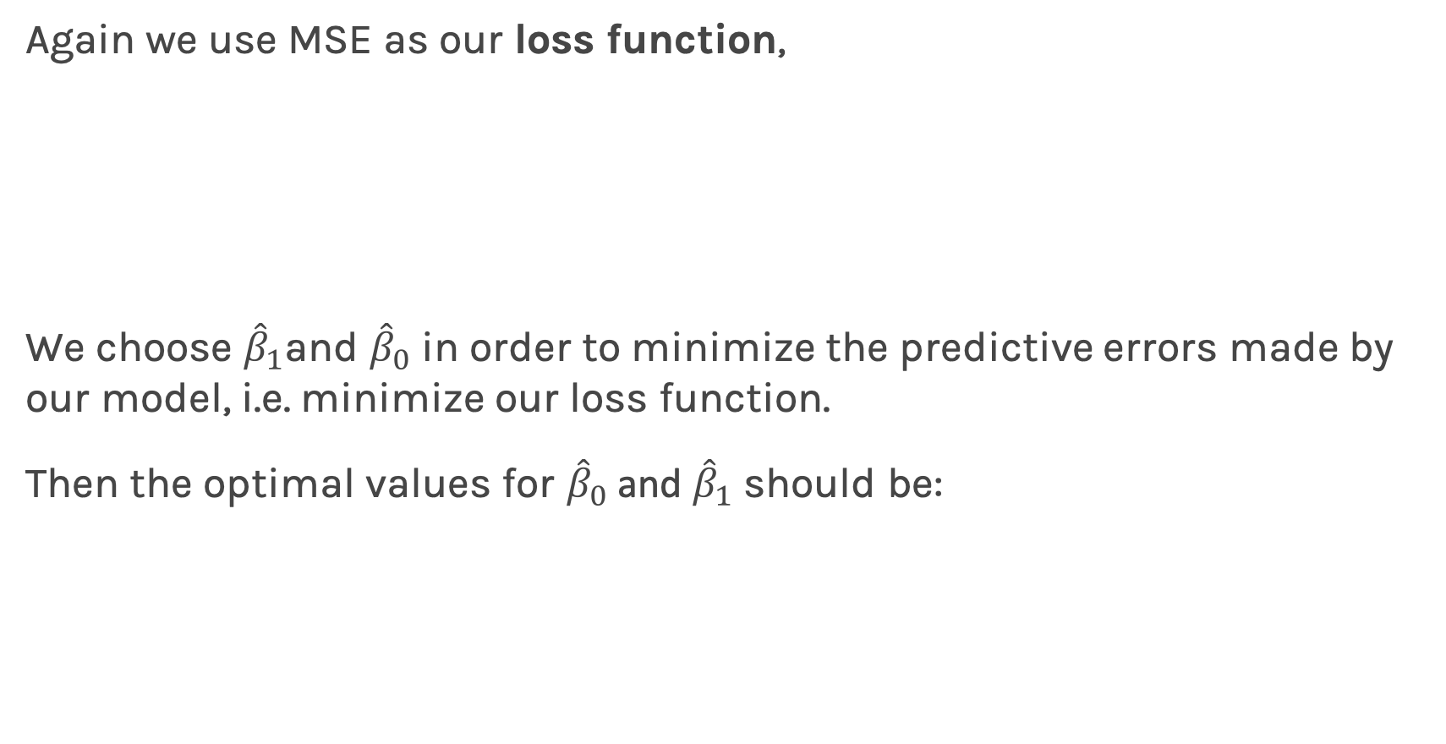
Estimate of the regression coefficients (cont)
Again we use MSE as our loss function,
We choose ${\hat{β}}_{1}$and ${\hat{β}}_{0}$ in order to minimize the predictive errors made by our model, i.e. minimize our loss function.
Then the optimal values for ${\hat{β}}_{0}$ and ${\hat{β}}_{1}$ should be:

Slide 16
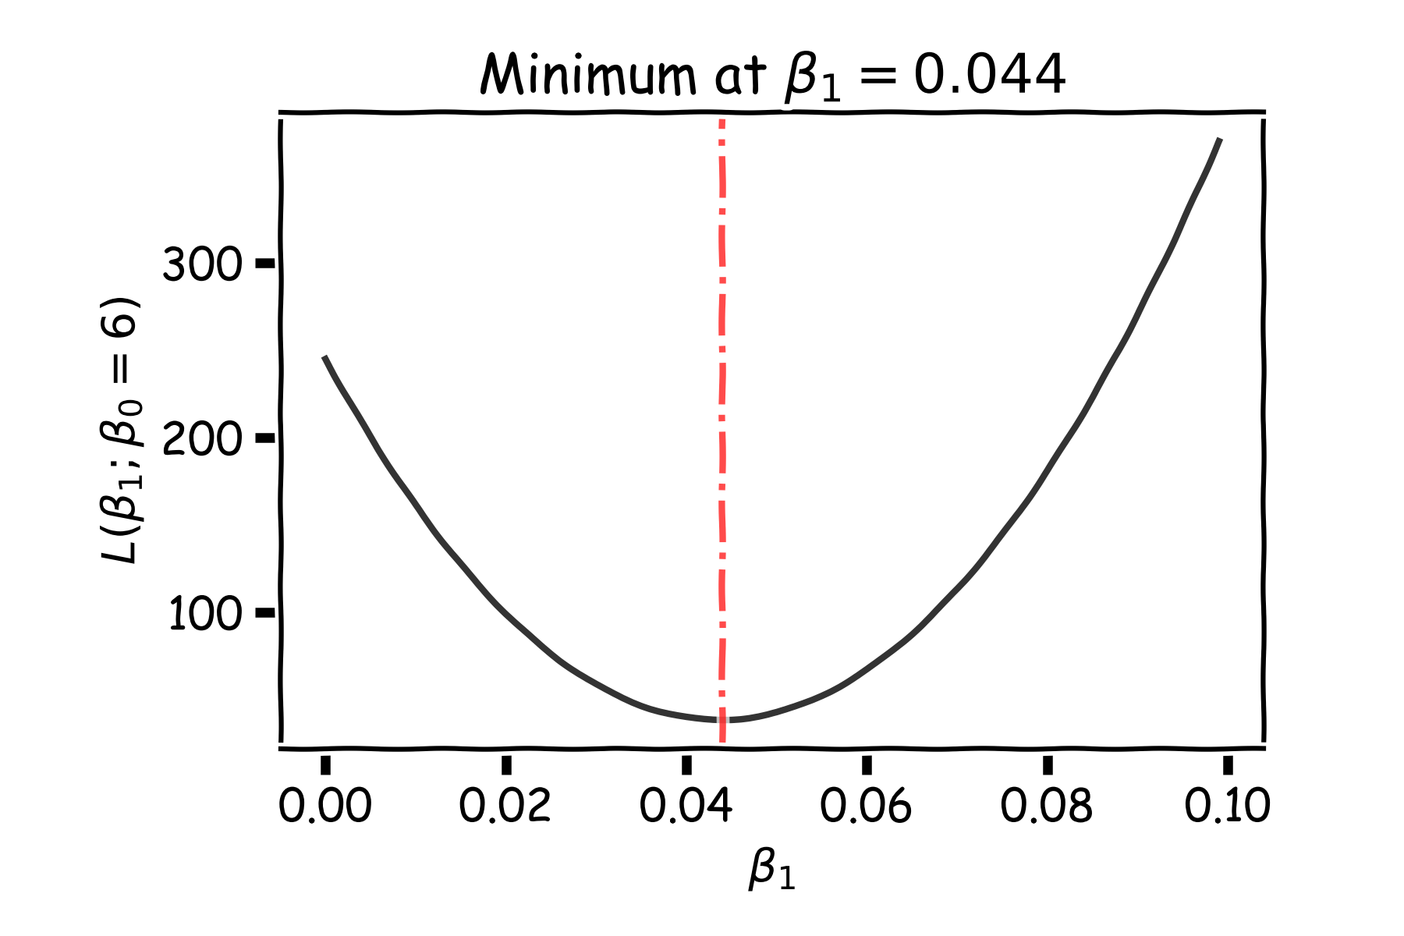
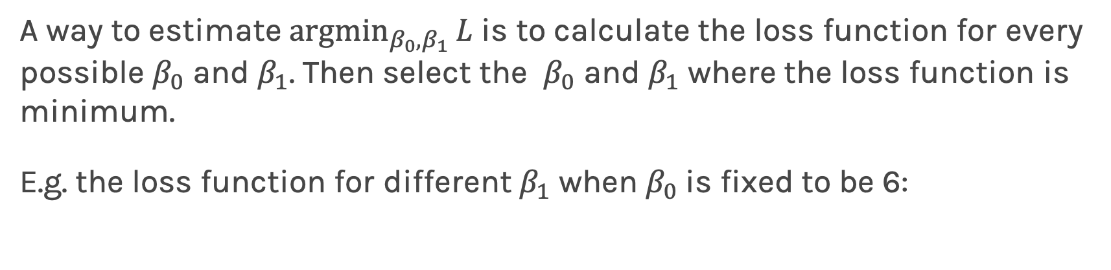
Estimate of the regression coefficients: brute force
A way to estimate ${argmin}_{β_{0},β_{1}}{L}$ is to calculate the loss function for every possible $β_{0}$ and $β_{1}$. Then select the $β_{0}$ and $β_{1}$ where the loss function is minimum.
E.g. the loss function for different $β_{1}$ when $β_{0}$is fixed to be 6:
Notes:
The problem with brute force is that it’s “expensive”. It takes a lot of calculation to go through all possibilities of b0 and b1 and find the minimum.

Slide 17
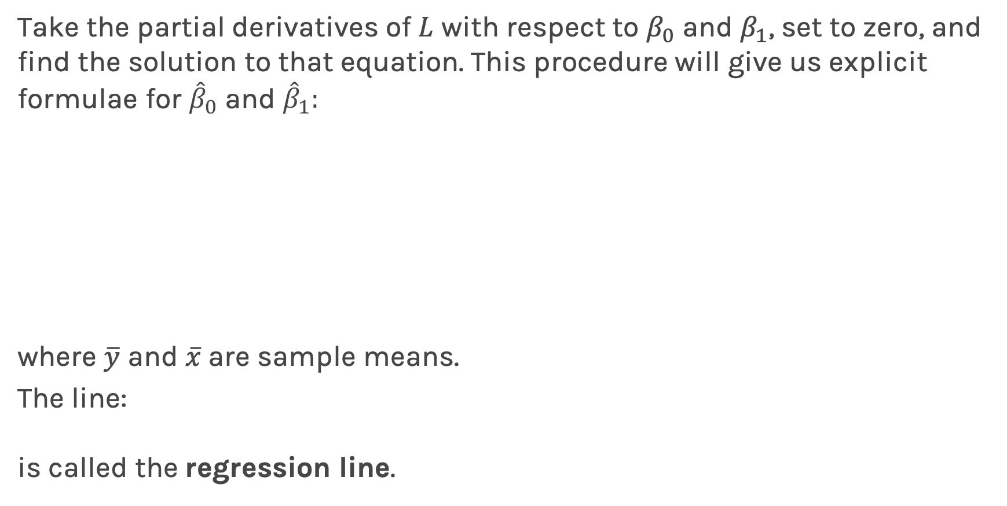
Estimate of the regression coefficients: exact method
Take the partial derivatives of $L$ with respect to $β_{0}$ and $β_{1}$, set to zero, and find the solution to that equation. This procedure will give us explicit formulae for ${\hat{β}}_{0}$ and ${\hat{β}}_{1}:$
where $\overline{y}$ and $\overline{x}$are sample means.
The line:
is called the regression line.

Slide 18
Notes:
Fix this

Slide 19
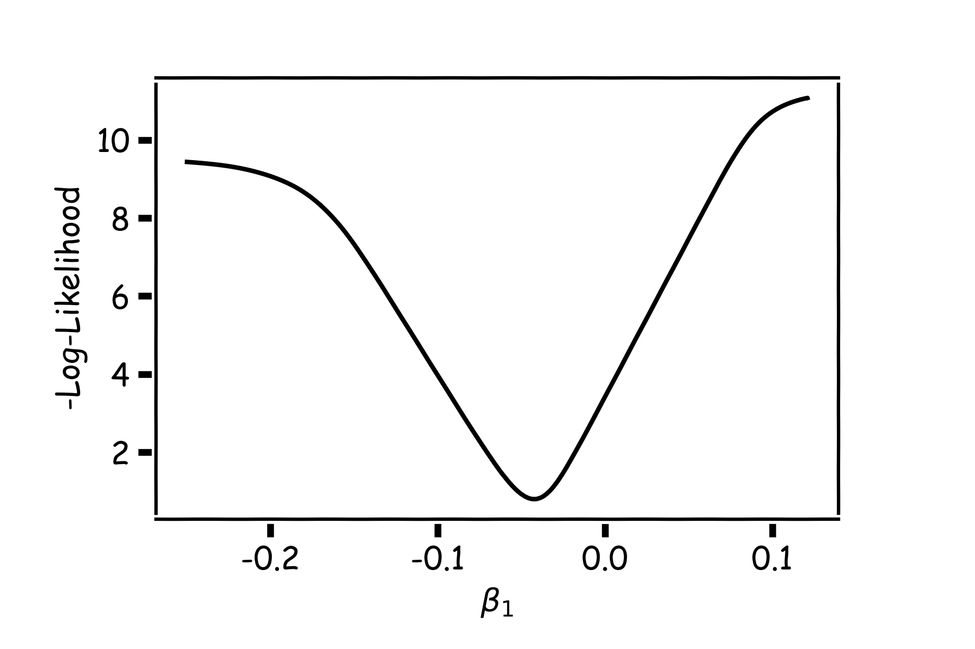
Estimate of the regression coefficients: gradient descent
A more flexible method is
Start from a random point
Determine which direction to go to reduce the loss (left or right)
Compute the slope of the function at this point and step to the right if slope is negative or step to the left if slope is positive
Go to to #1
Notes:
This is iterative.

Slide 20
Estimate of the regression coefficients: gradient descent
Question: What is the mathematical function that describes the slope?
Derivative
Question: What do you think it is a good approach for telling the model how to change (what is the step size) to become better?
If the step is proportional to the slope then you avoid overshooting the minimum
Question: How do we generalize this to more than one predictor?
Take the derivative with respect to each coefficient and do the same sequentially
Notes:
S

Slide 21
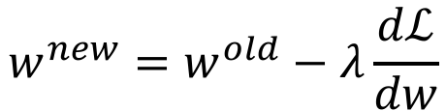
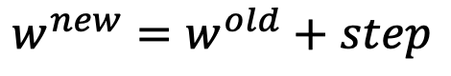
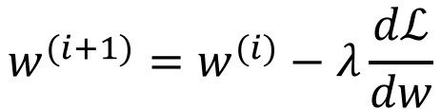
Estimate of the regression coefficients: gradient descent
We know that we want to go in the opposite direction of the derivative and we know we want to be making a step proportionally to the derivative.
Making a step means:
Notation: $w=β_{0}, β_{1}$
Learning Rate
$${w^{new}=w}^{old}+step$$
Opposite direction of the derivative and proportional to the derivative means:
$${w^{new}=w}^{old}−λ\frac{dℒ}{dw}$$
Change to more conventional notation:
$${w^{(i+1)}=w}^{(i)}−λ\frac{dℒ}{dw}$$

Slide 22
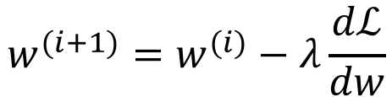
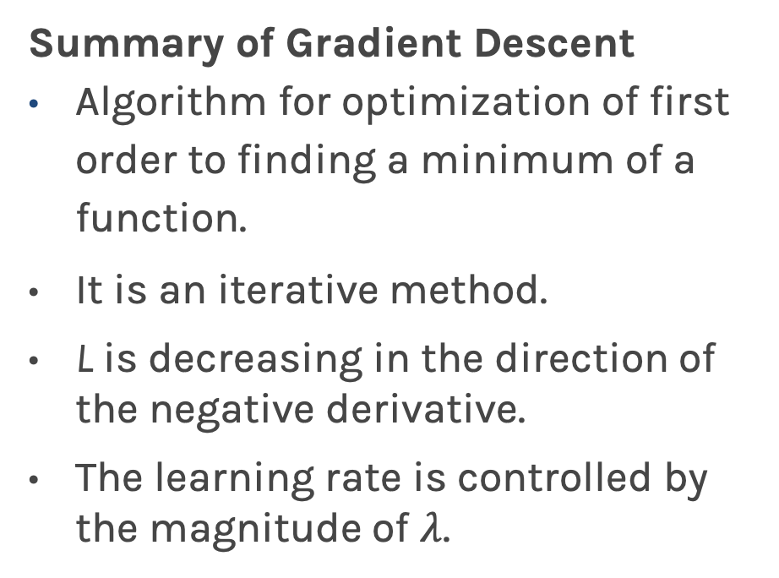
Estimate of the regression coefficients: gradient descent
Summary of Gradient Descent
Algorithm for optimization of first order to finding a minimum of a function.
It is an iterative method.
L is decreasing in the direction of the negative derivative.
The learning rate is controlled by the magnitude of $λ$.
$${w^{(i+1)}=w}^{(i)}−λ\frac{dℒ}{dw}$$
L
-
+
w

Slide 23
Gradient Descent: considerations
Gradient Descent Considerations (more in coming lectures)
We still need to derive or compute the derivatives.
We need to know what is the learning rate or how to set it.
We need to avoid local minima.
Finally, the full loss function includes summing up all individual ‘errors’. This can be hundreds of thousands of examples.
L
-
+
w

Slide 24
Gradient Descent: considerations
Gradient Descent Considerations (more in coming lectures)
We still need to derive or compute the derivatives
We need to know what is the learning rate or how to set it
We need to avoid local minima
Finally, the full loss function includes summing up all individual ‘errors’. This can be hundreds of thousands of examples.
-
+
In linear regression, there are no local minima because the loss function is convex
In linear regression, we often use the exact formula
We will talk about optimization again in Neural Network lecture and the last advanced sections
L
w
Notes:
When you use the .fit method in SKLearn it computes the best regression line by just taking the derivative of the Loss function (and not by using gradient descent)

Slide 25
Lecture Outline
Linear models
Estimate of the regression coefficients
Brute Force
Exact method
Gradient Descent
Confidence intervals for the predictors estimates
Bootstrap
Evaluating Significance of Predictors
How well we know the model $\hat{f}$

Slide 26
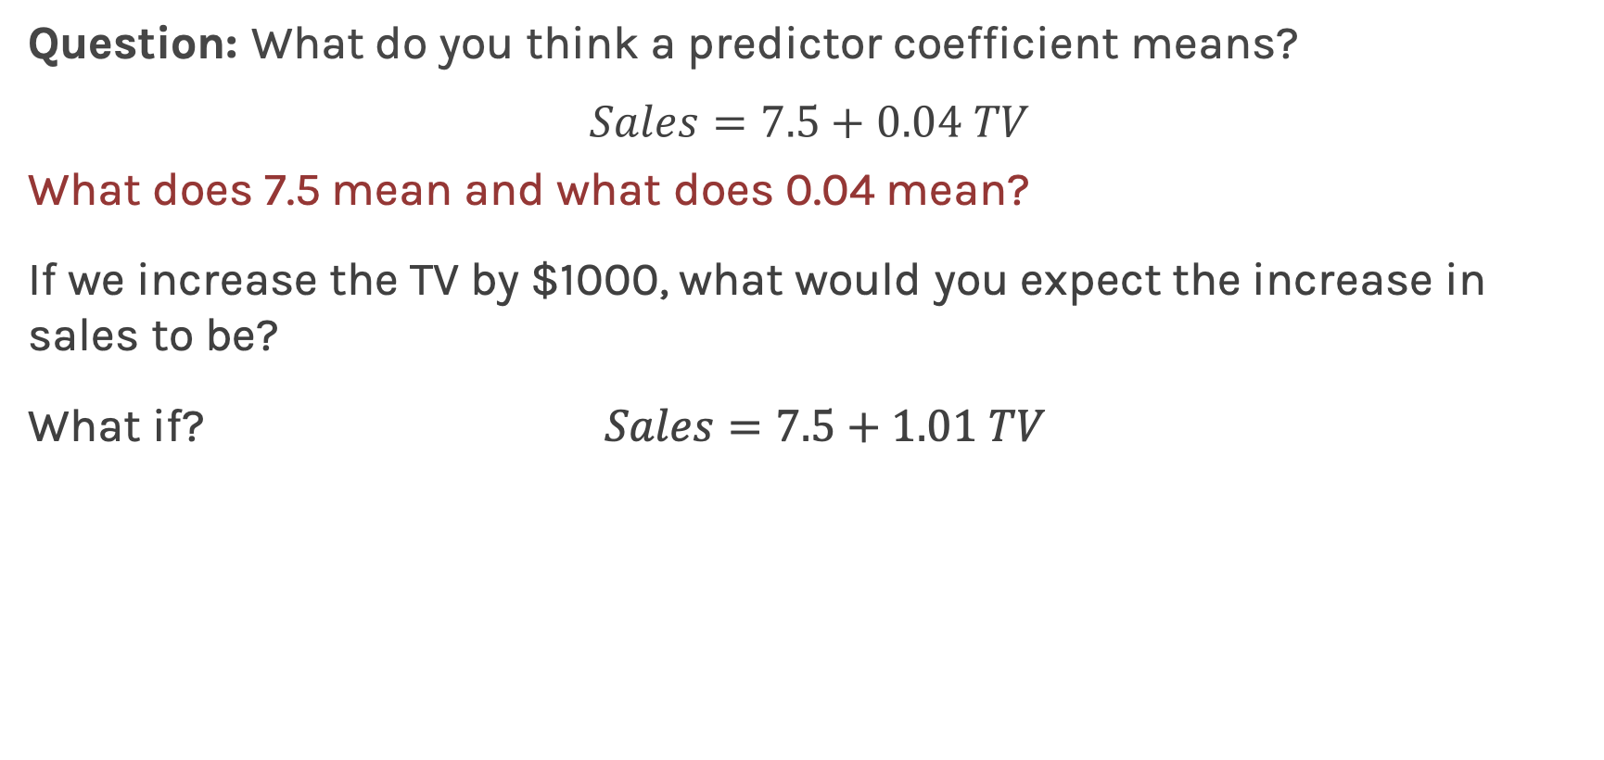
Interpretation of Predictors
Question: What do you think a predictor coefficient means?
$$Sales=7.5+0.04 TV$$
What does 7.5 mean and what does 0.04 mean?
If we increase the TV by $1000, what would you expect the increase in sales to be?
What if? $Sales=7.5+1.01 TV$
The interpretation of the predictors depends on the values but decisions depend on how much we trust these values.
Notes:
Axes labels! (DLS)

Slide 27
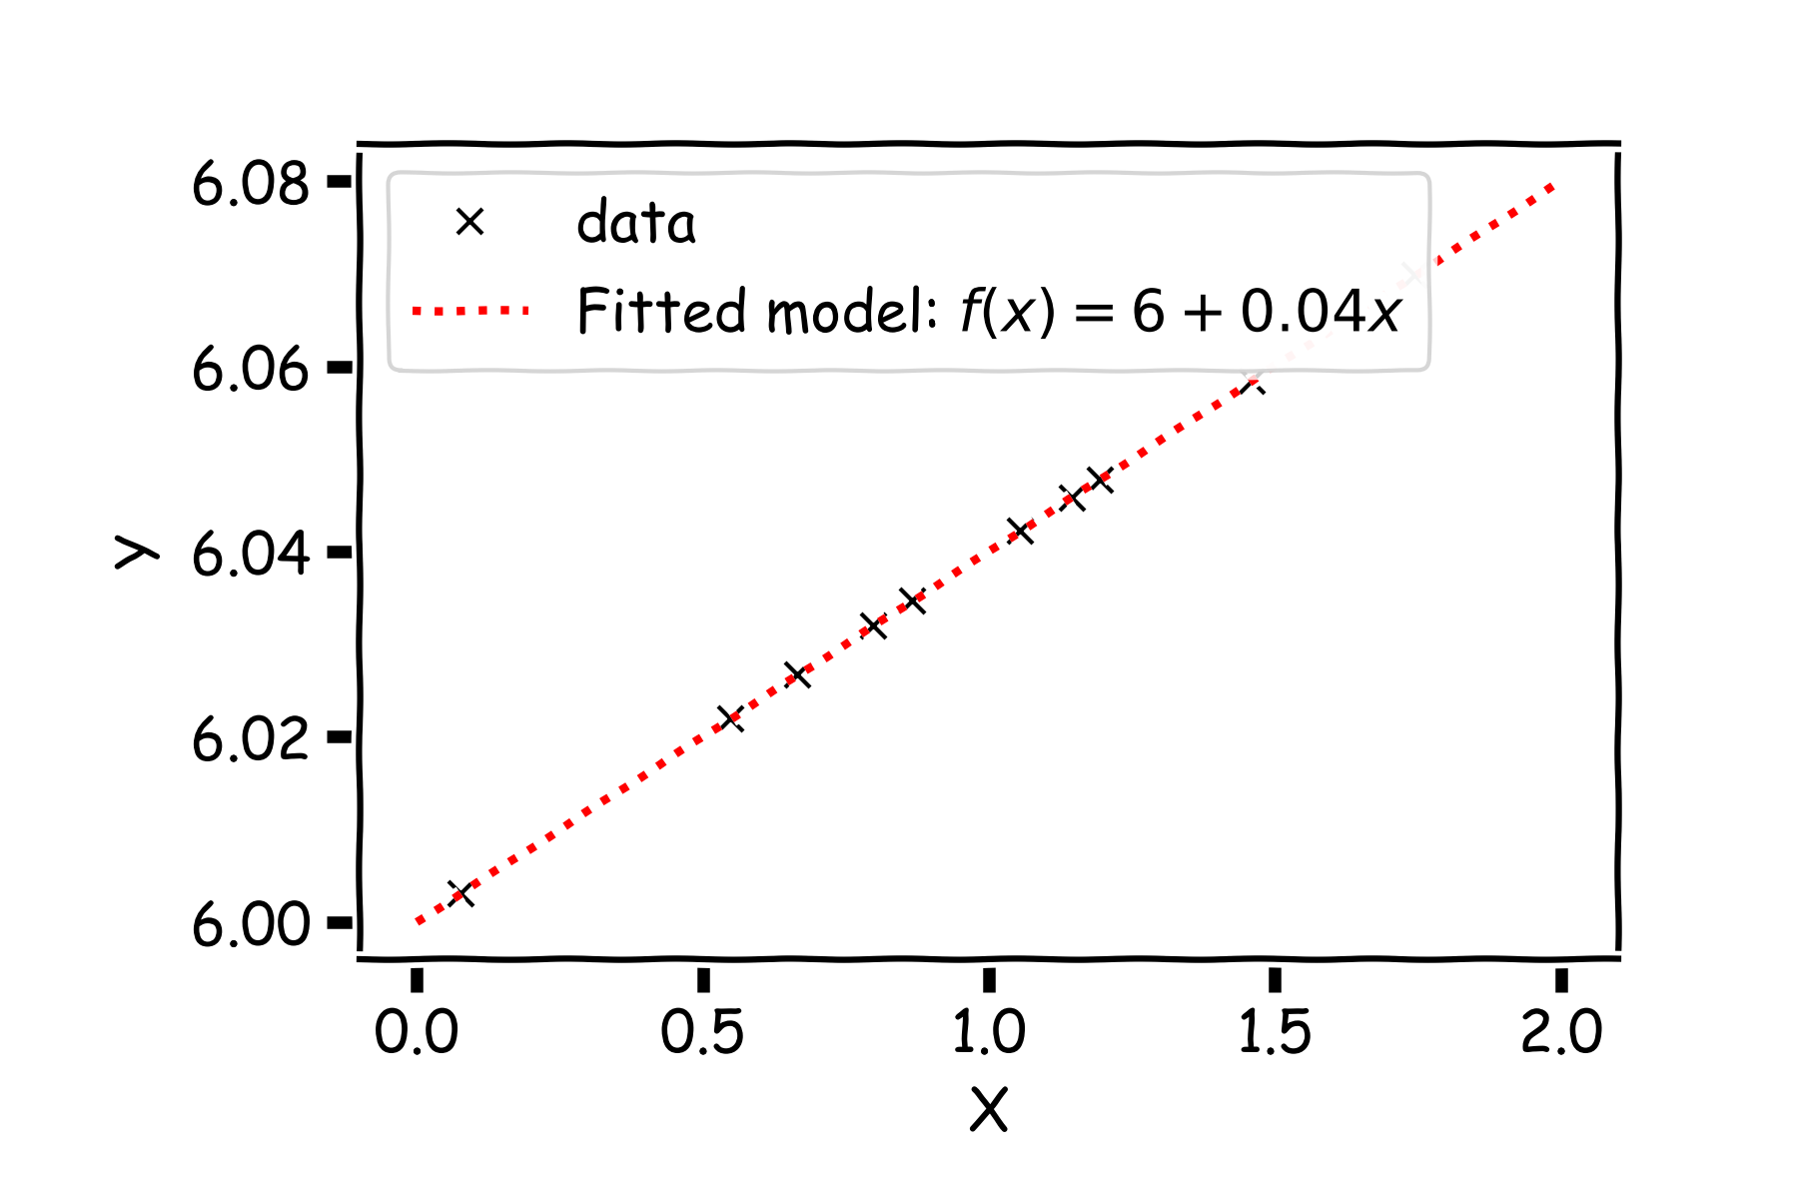
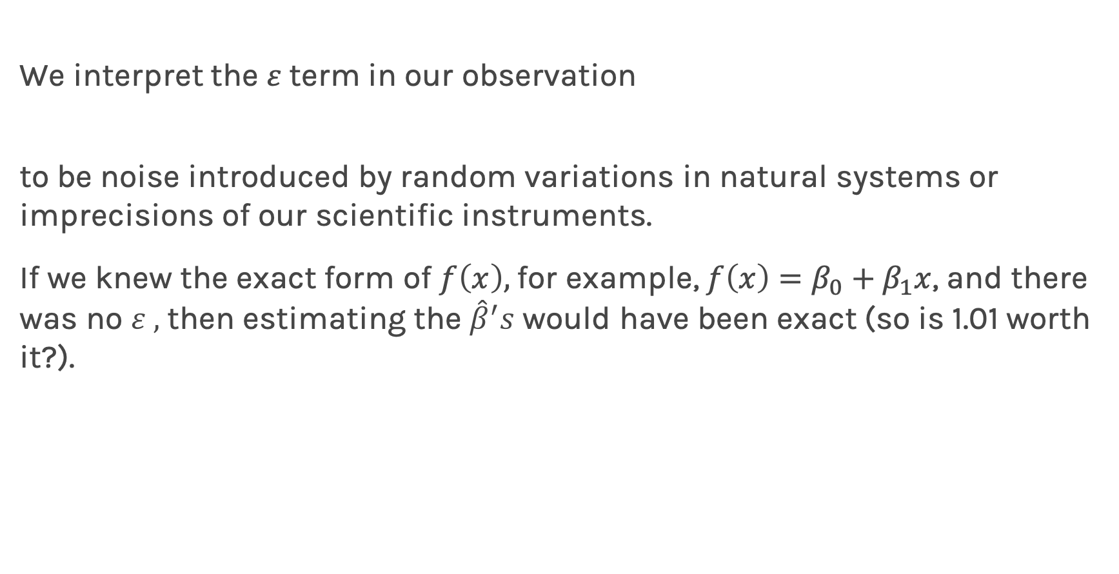
Confidence intervals for the predictors estimates
We interpret the $ε$term in our observation
to be noise introduced by random variations in natural systems or imprecisions of our scientific instruments.
If we knew the exact form of $f\left(x\right),$for example, $f\left(x\right)=β_{0}+β_{1}x$, and there was no $ε ,$ then estimating the ${\hat{β}}^{′}s$ would have been exact (so is 1.01 worth it?).
Notes:
Axes labels! (DLS)

Slide 28
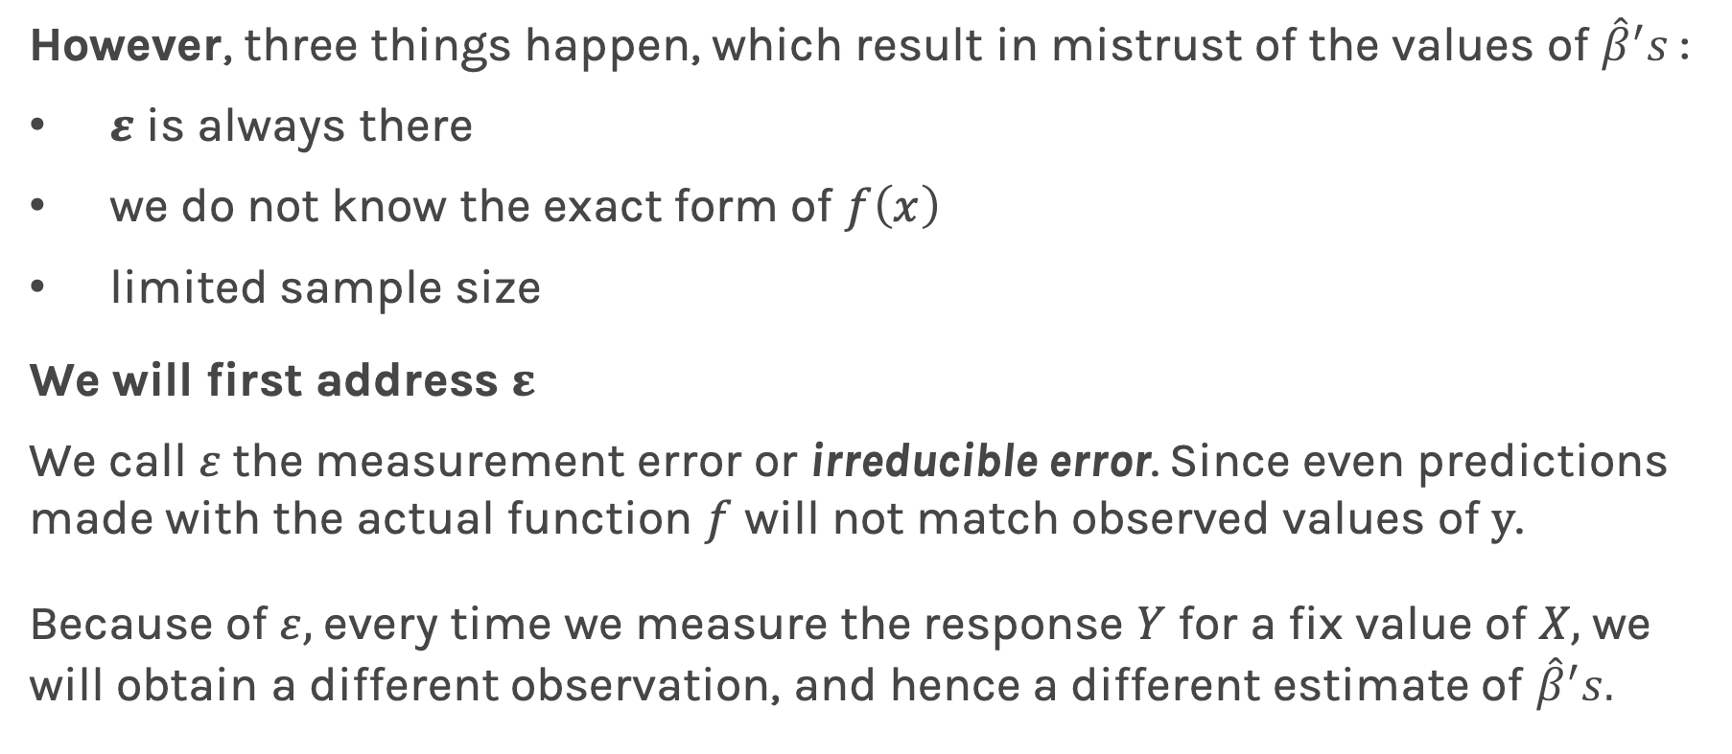
Confidence intervals for the predictors estimates (cont)
However, three things happen, which result in mistrust of the values of ${\hat{β}}^{′}s$:
$ε$ is always there
we do not know the exact form of $f\left(x\right)$
limited sample size
We will first address $ε$
We call $ε$the measurement error or irreducible error. Since even predictions made with the actual function $f$ will not match observed values of $y$.
Because of $ε,$ every time we measure the response $Y$ for a fix value of $X,$we will obtain a different observation, and hence a different estimate of ${\hat{β}}^{′}s.$

Slide 29
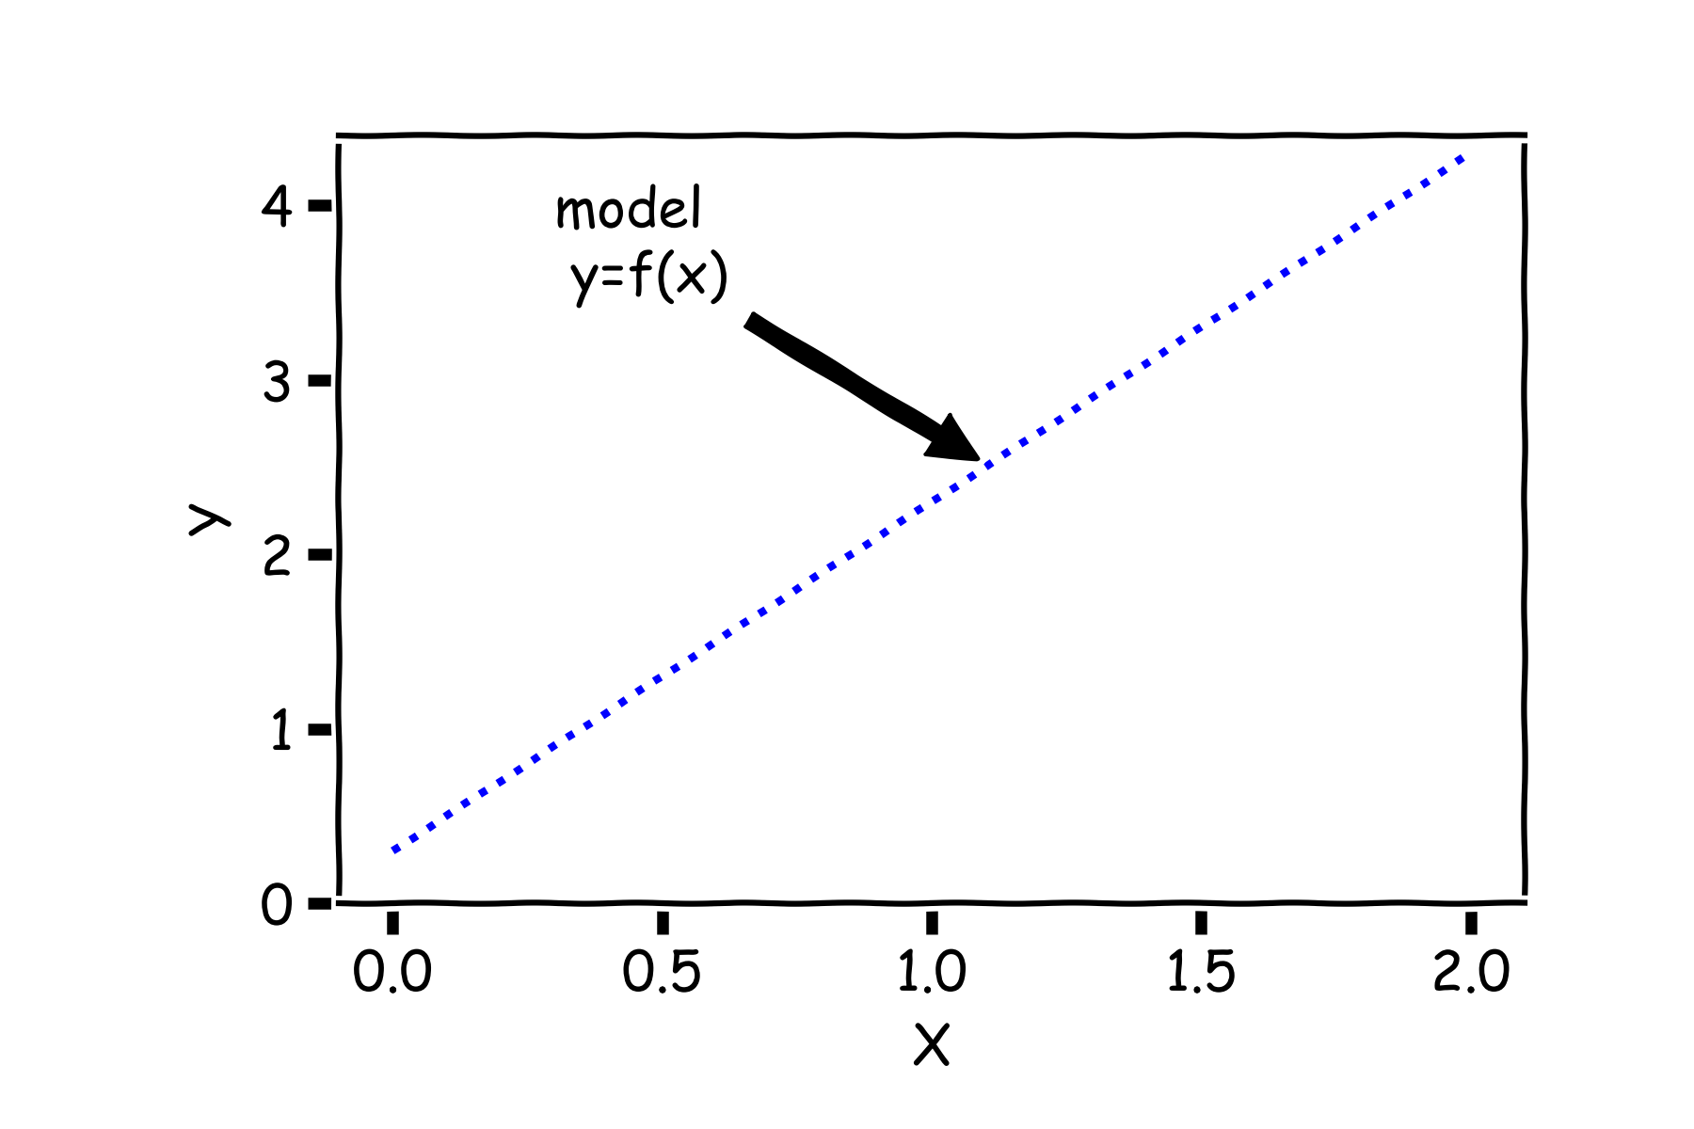
Confidence intervals for the predictors estimates (cont)
Start with a model

Slide 30
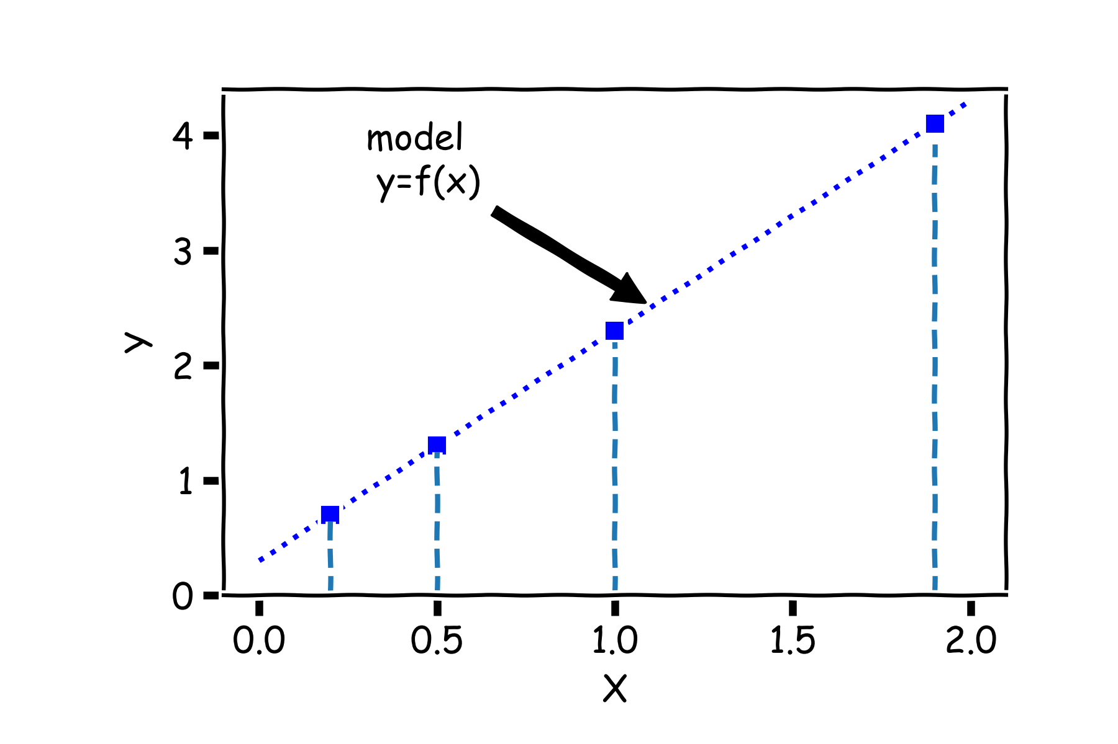
Confidence intervals for the predictors estimates (cont)
For a some values of $X,$ $Y=f(X)$

Slide 31
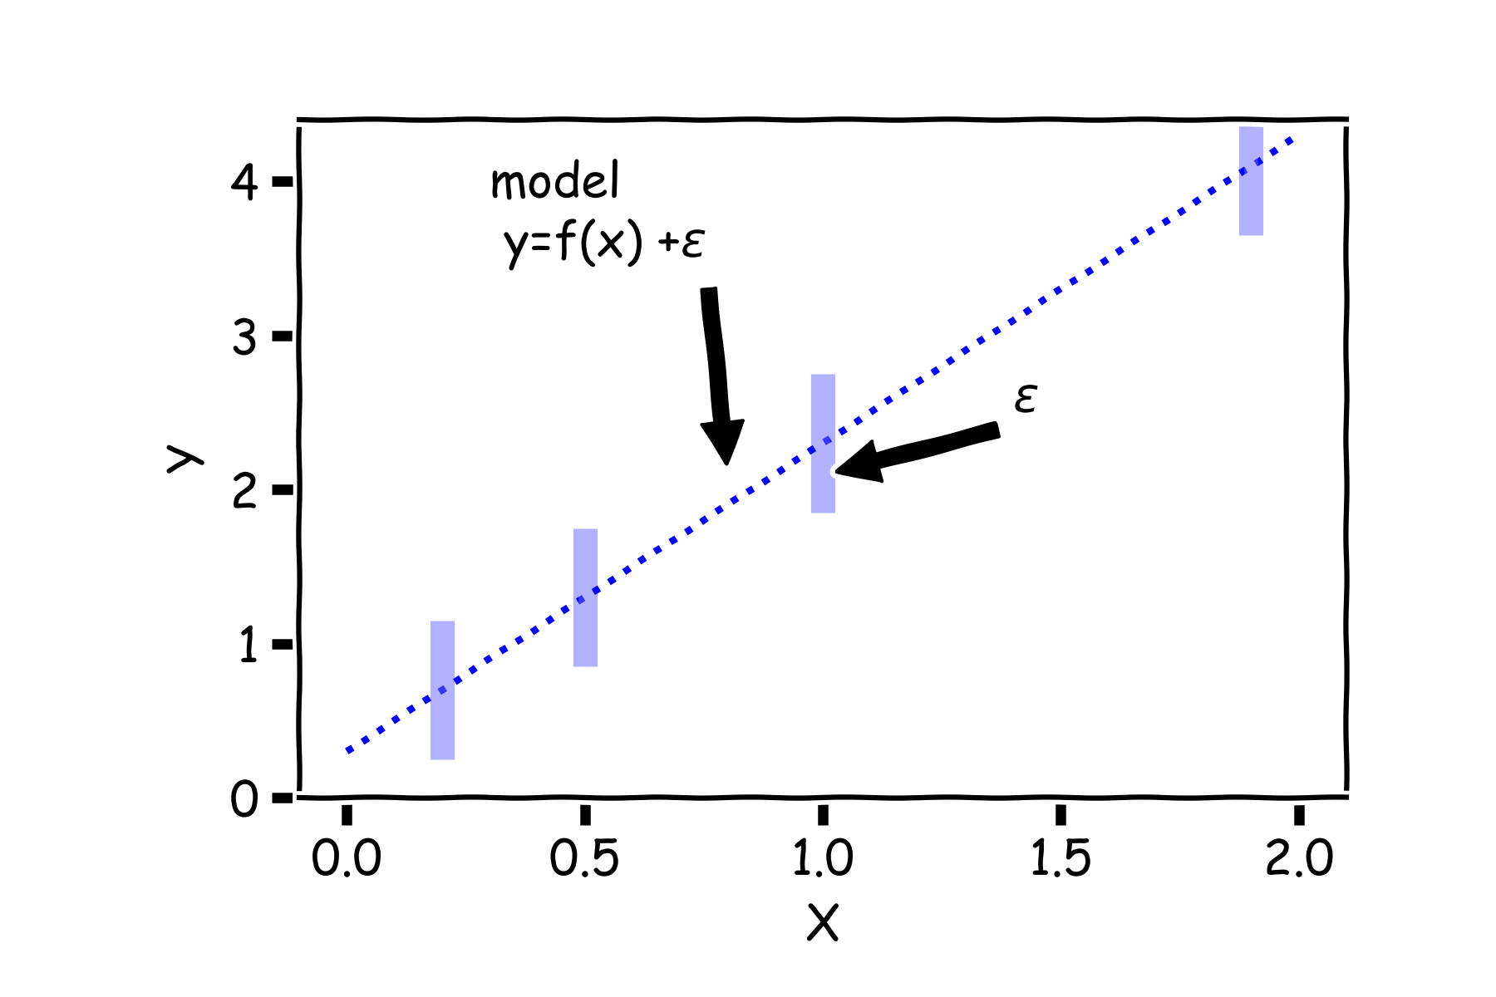
Confidence intervals for the predictors estimates (cont)
But due to error, every time we measure the response Y for a fixed value of X we will obtain a different observation.

Slide 32
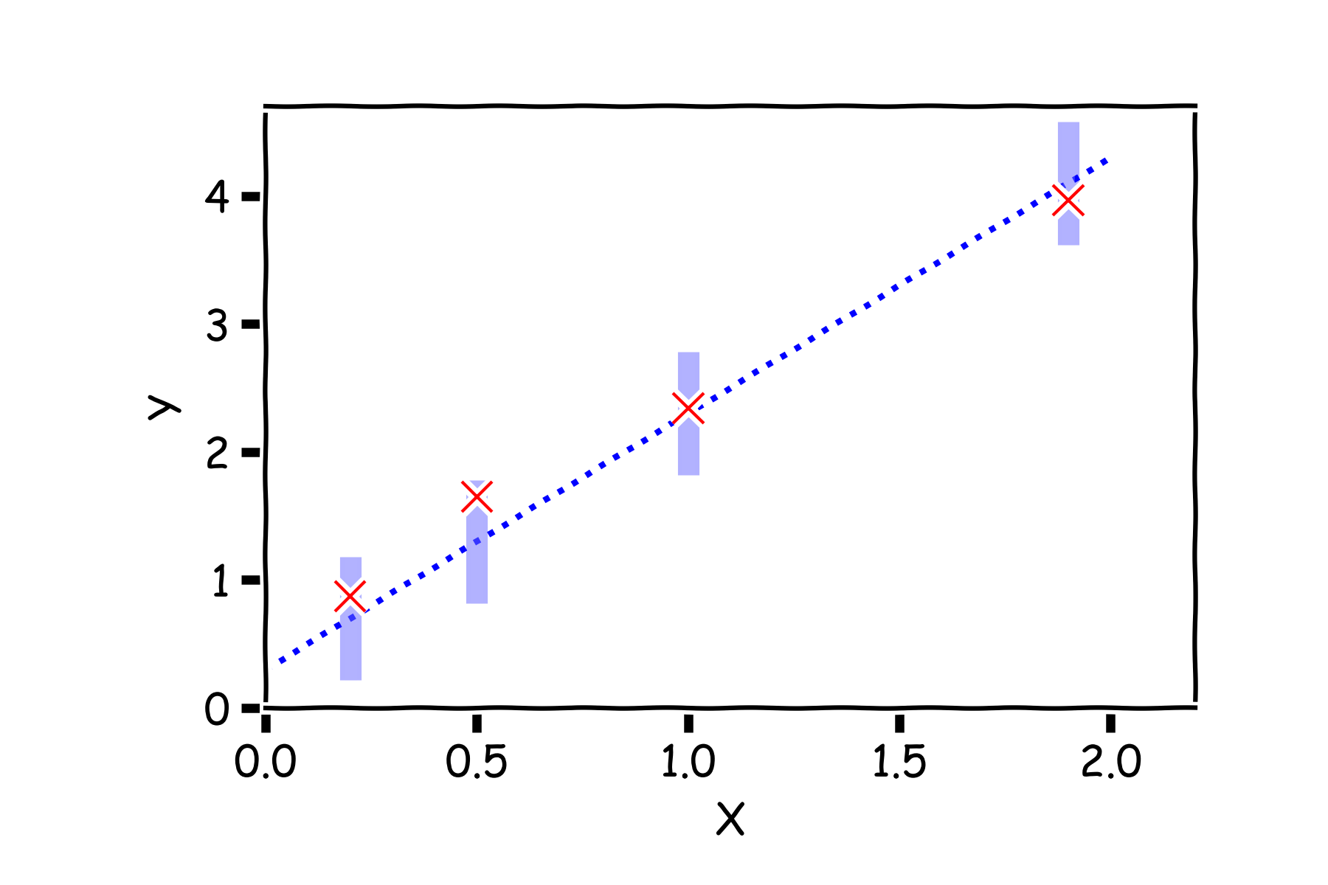
Confidence intervals for the predictors estimates (cont)
One set of observations, “one realization” we obtain one set of Ys (red crosses).

Slide 33
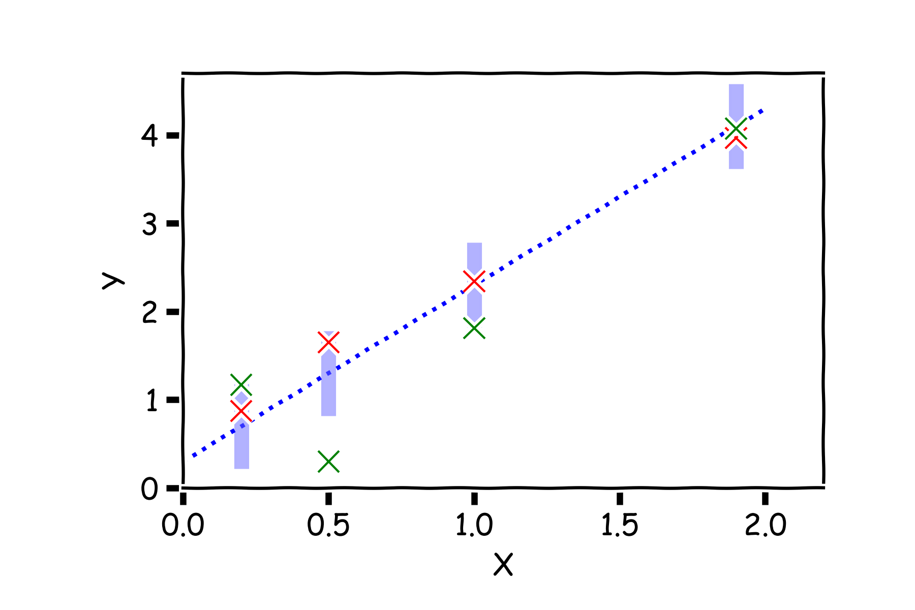
Confidence intervals for the predictors estimates (cont)
Another set of observations, “another realization” we obtain another set of Ys (green crosses).

Slide 34
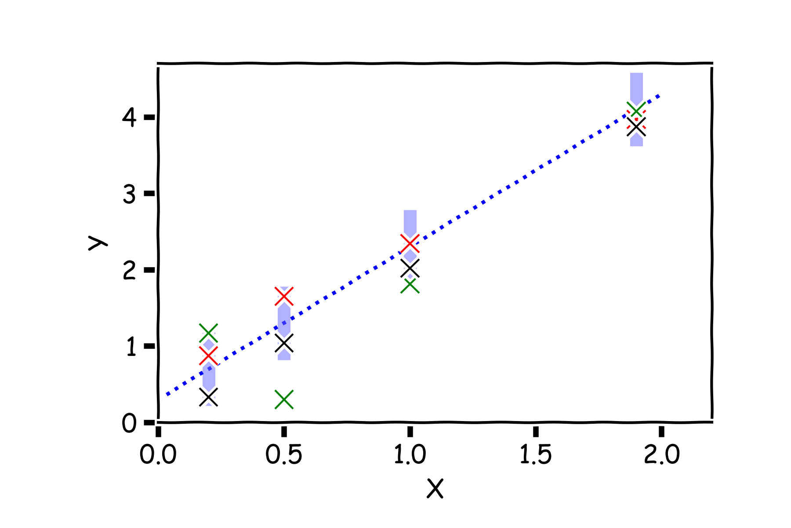
Confidence intervals for the predictors estimates (cont)
Another set of observations, “another realization” we obtain another set of Ys (black crosses).

Slide 35
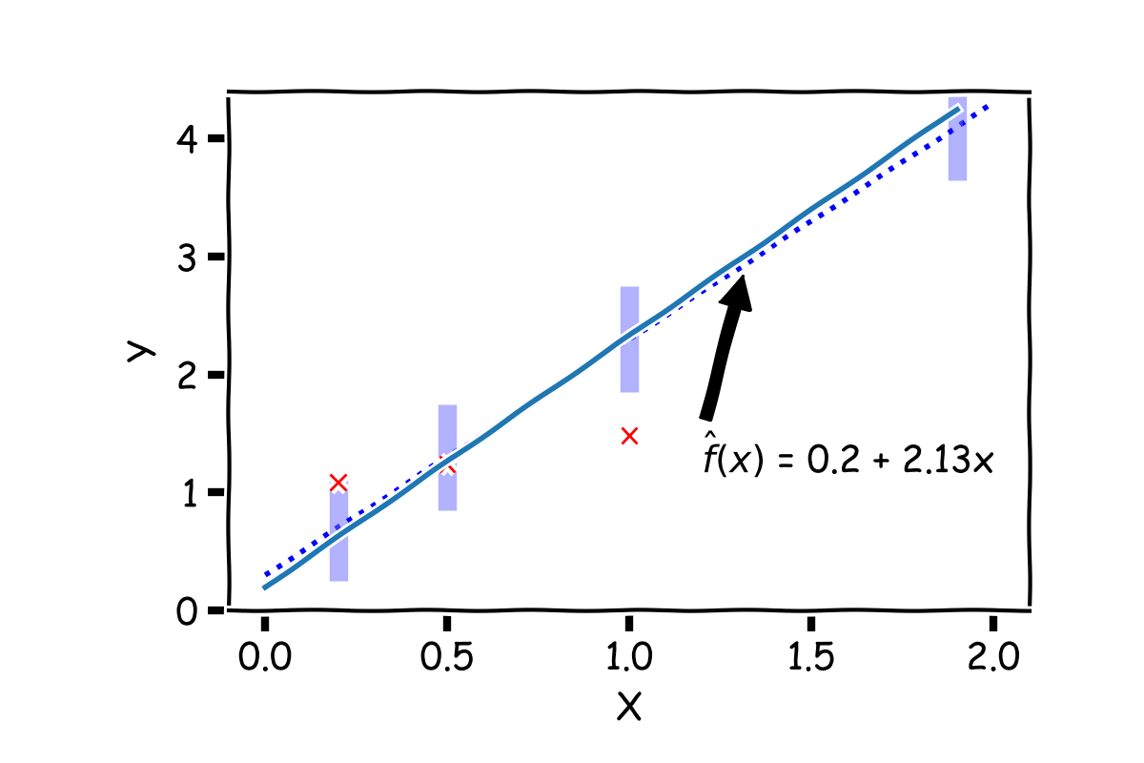
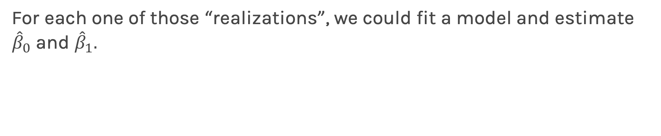
Confidence intervals for the predictors estimates (cont)
For each one of those “realizations”, we could fit a model and estimate ${\hat{β}}_{0}$ and ${\hat{β}}_{1}.$

Slide 36
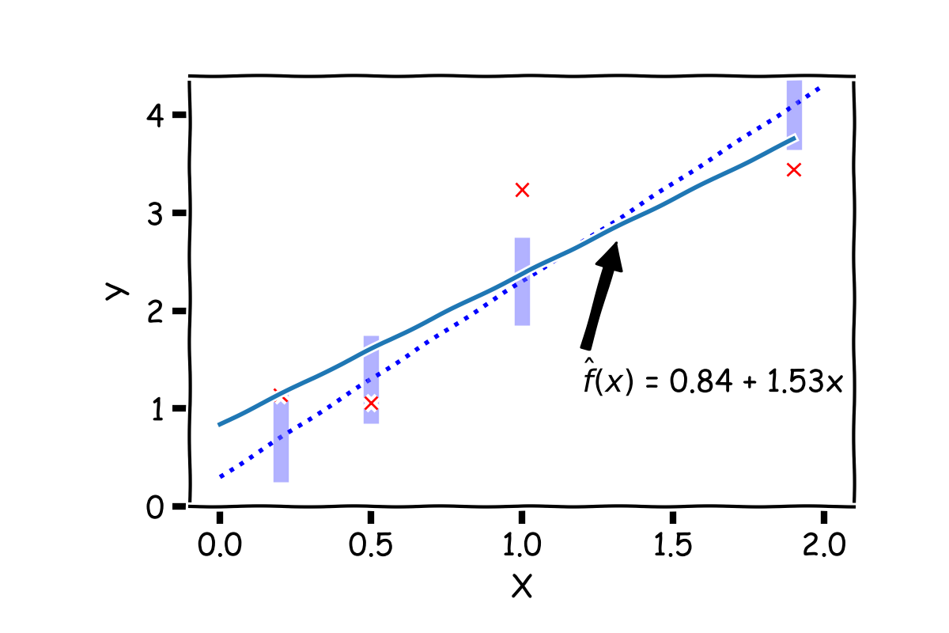
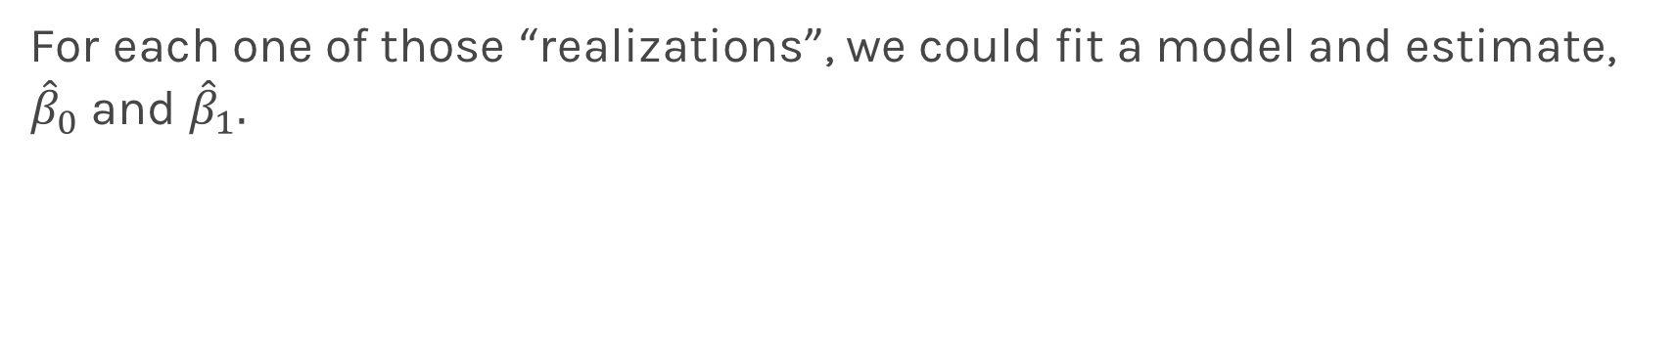
Confidence intervals for the predictors estimates (cont)
For each one of those “realizations”, we could fit a model and estimate, ${\hat{β}}_{0}$ and ${\hat{β}}_{1}.$

Slide 37
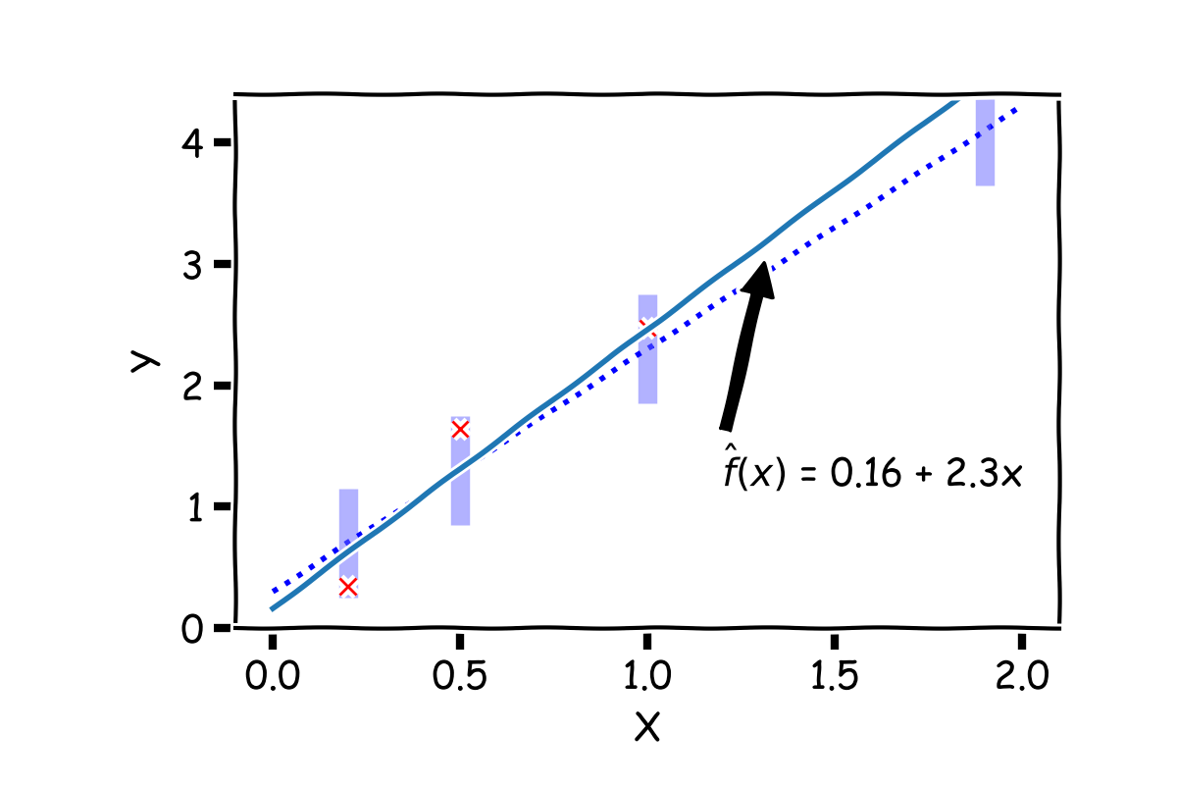
Confidence intervals for the predictors estimates (cont)
For each one of those “realizations”, we could fit a model and estimate, ${\hat{β}}_{0}$ and ${\hat{β}}_{1}.$

Slide 38

Confidence intervals for the predictors estimates (cont)
So if we just have one set of measurements of $\{X,Y\},$our estimates of ${\hat{β}}_{0}$ and ${\hat{β}}_{1}$ are just for this particular realization.
Notes:
Gabriel García Márquez, whose novel One Hundred Years of Solitude … magic realism.

Slide 39
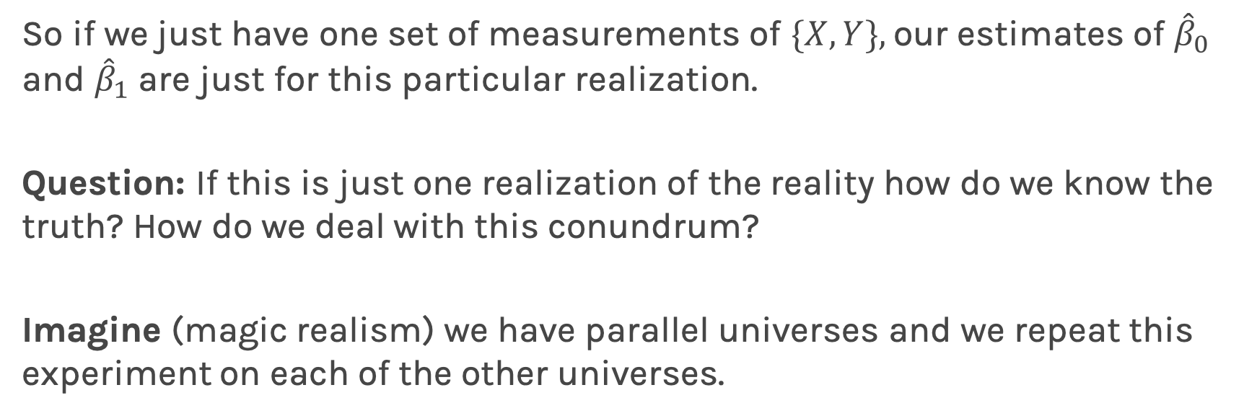
Confidence intervals for the predictors estimates (cont)
So if we just have one set of measurements of $\{X,Y\},$our estimates of ${\hat{β}}_{0}$ and ${\hat{β}}_{1}$ are just for this particular realization.
Question: If this is just one realization of the reality how do we know the truth? How do we deal with this conundrum?
Imagine (magic realism) we have parallel universes and we repeat this experiment on each of the other universes.
Universe A
Universe B
Universe C
Notes:
Gabriel García Márquez, whose novel One Hundred Years of Solitude … magic realism.

Slide 40
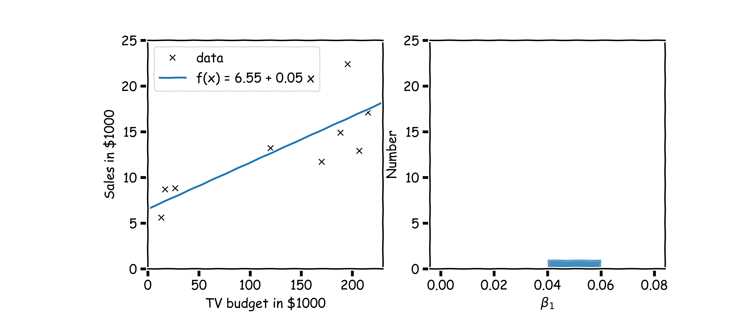
Confidence intervals for the predictors estimates (cont)
$$.$$
In our magical realisms, we can now sample multiple times

Slide 41
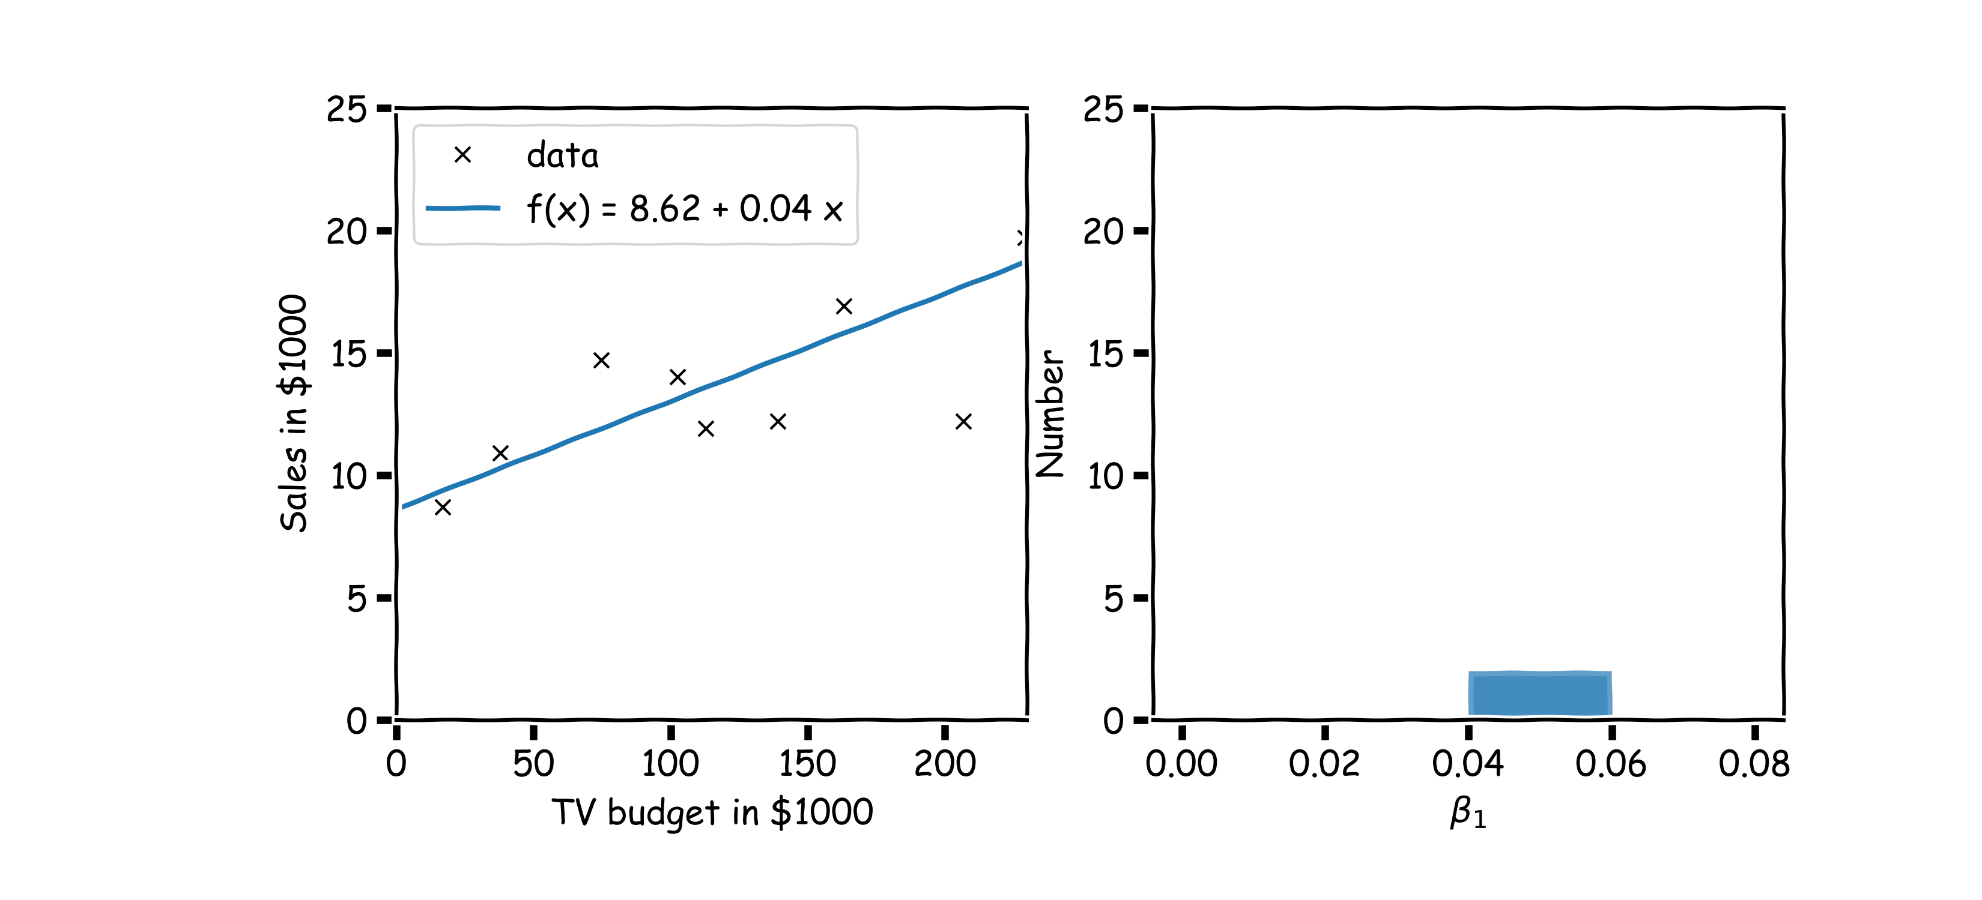
Confidence intervals for the predictors estimates (cont)
Another sample

Slide 42
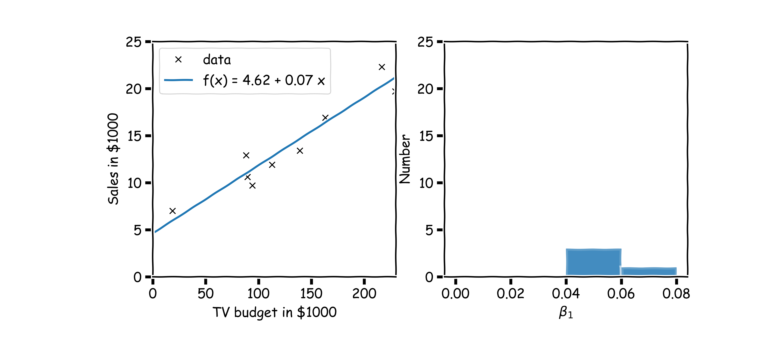
Confidence intervals for the predictors estimates (cont)
Another sample

Slide 43
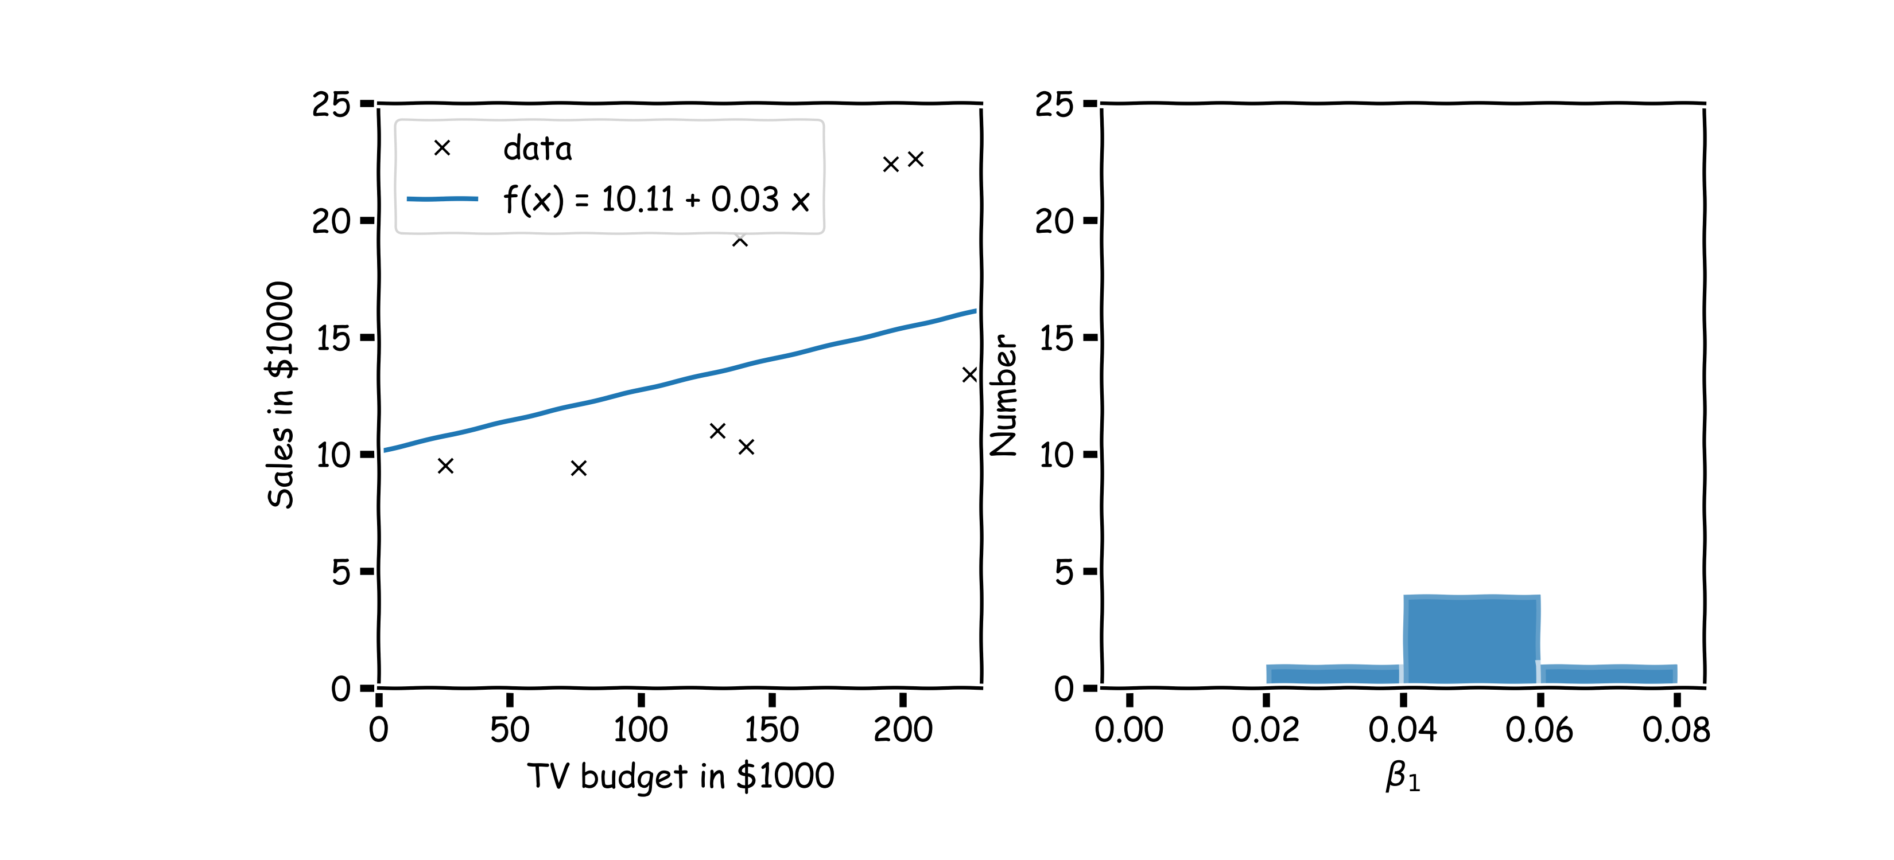
Confidence intervals for the predictors estimates (cont)
And another sample

Slide 44
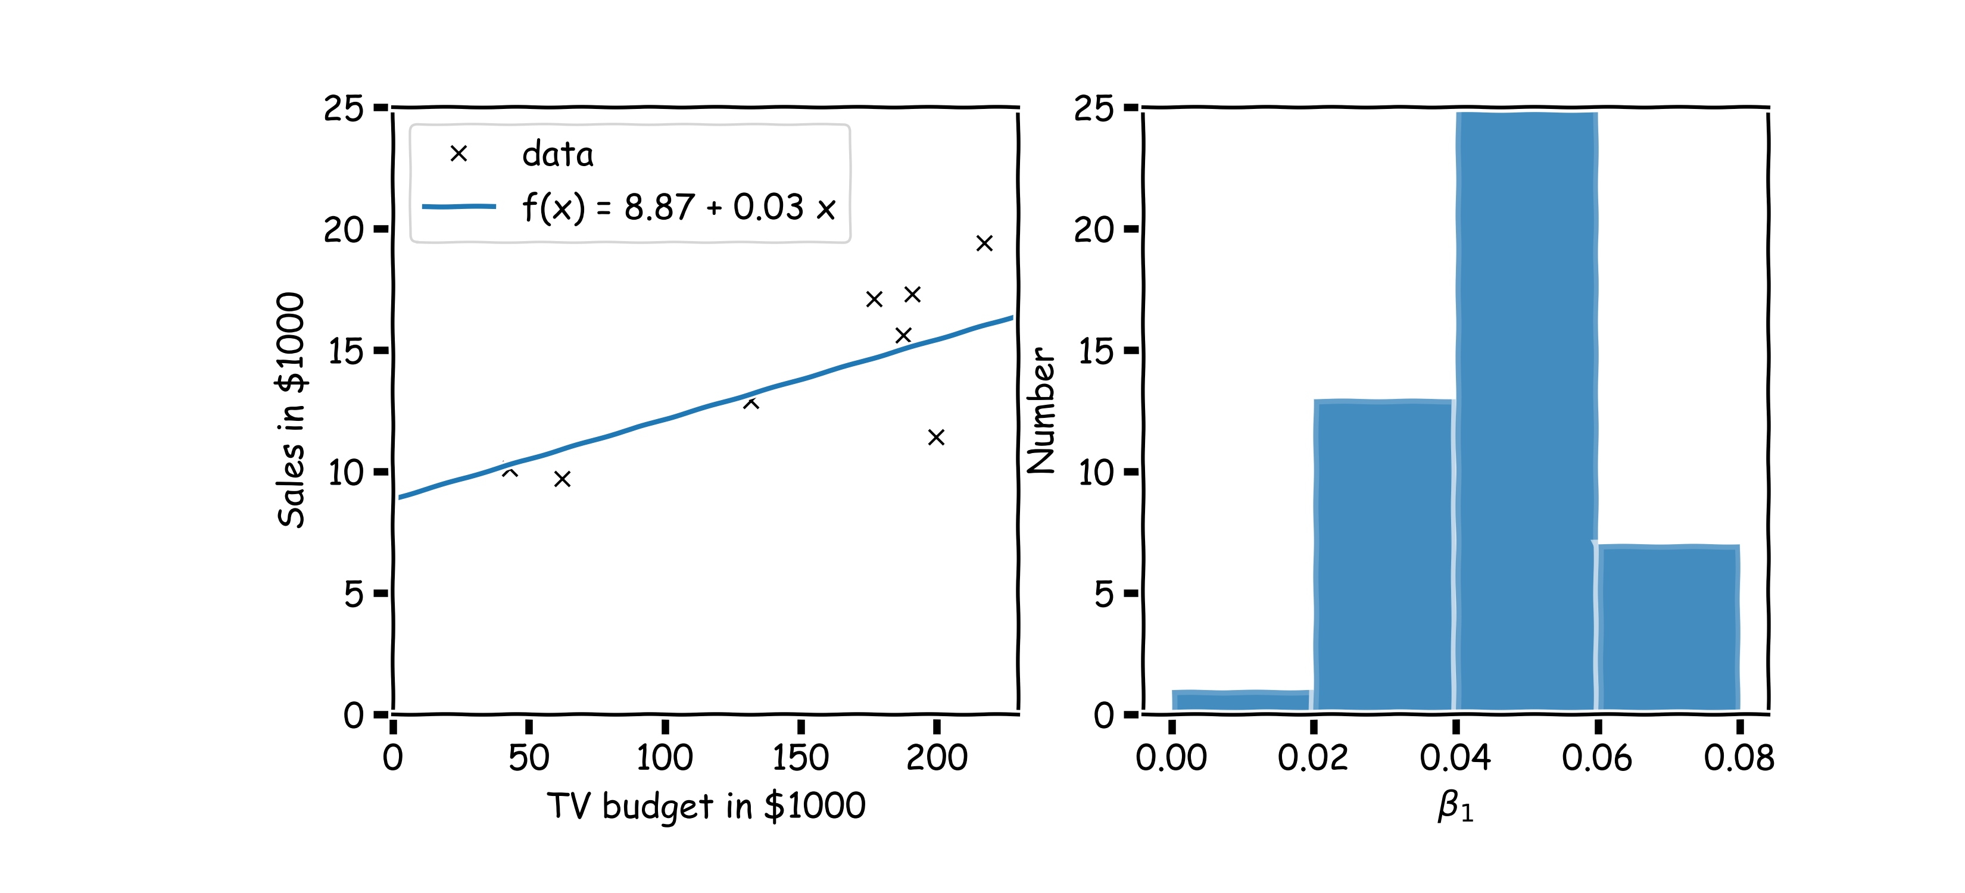
Confidence intervals for the predictors estimates (cont)
Repeat this for 100 times

Slide 45
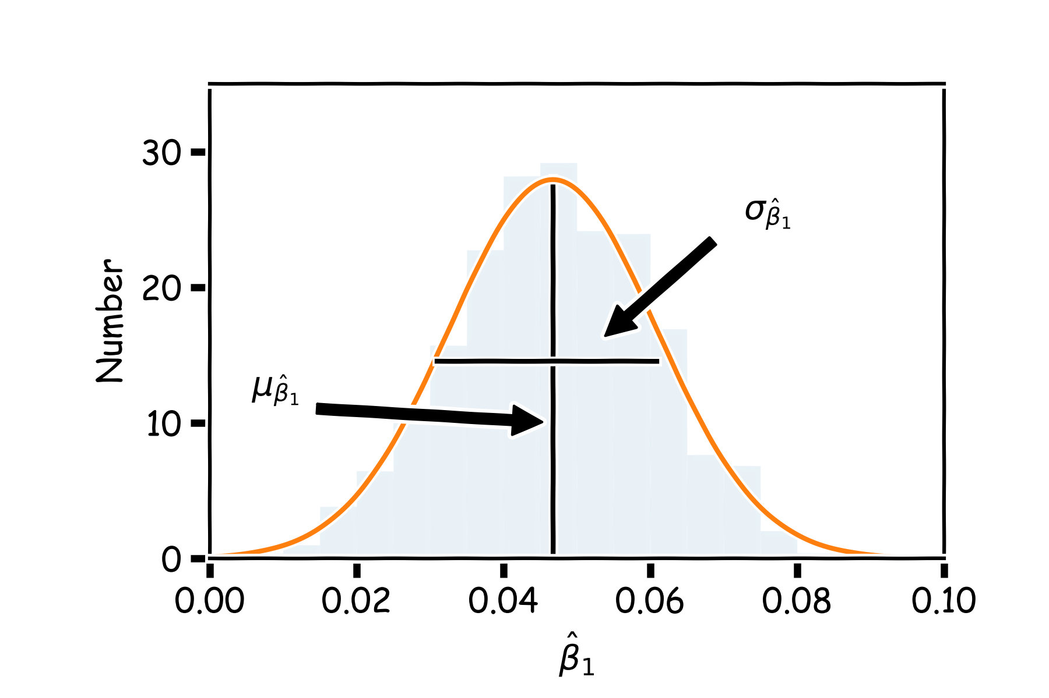
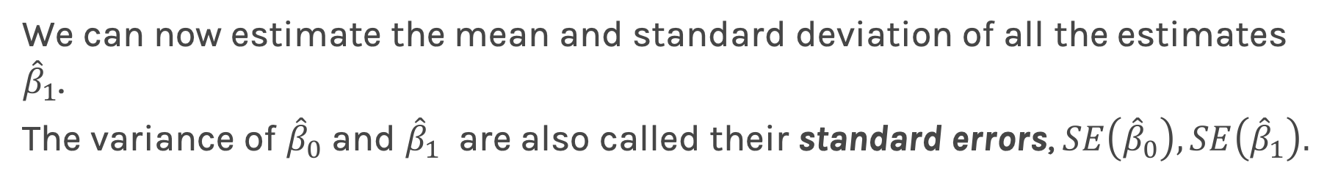
Confidence intervals for the predictors estimates (cont)
We can now estimate the mean and standard deviation of all the estimates ${\hat{β}}_{1}$.
The variance of ${\hat{β}}_{0}$ and ${\hat{β}}_{1}$ are also called their standard errors, $SE\left({\hat{β}}_{0}\right),SE\left({\hat{β}}_{1}\right).$

Slide 46
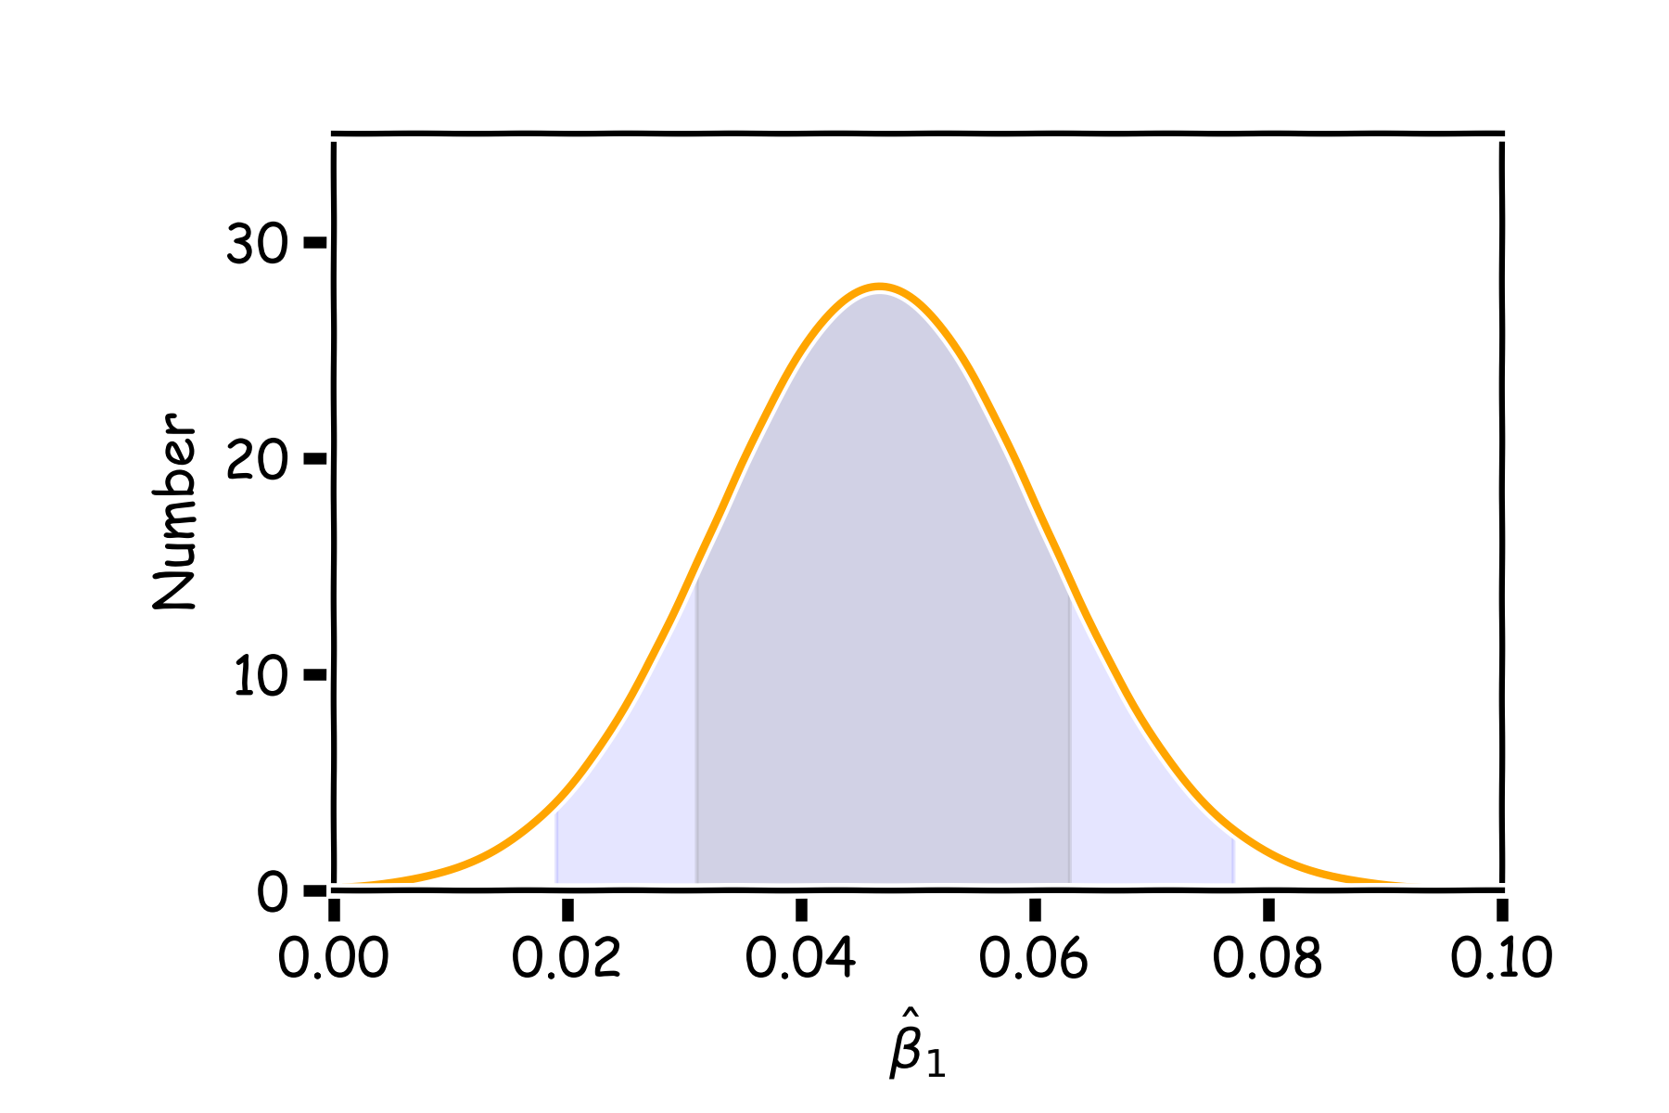
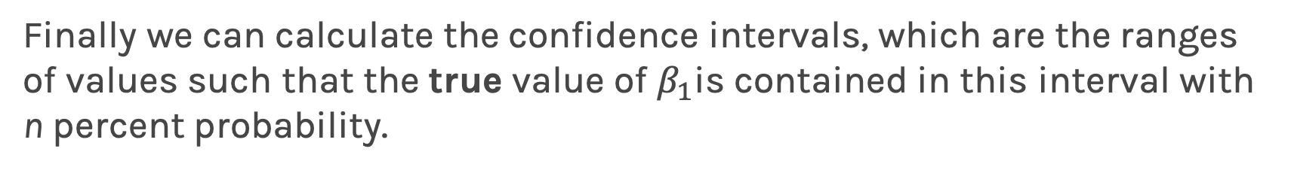
Confidence intervals for the predictors estimates (cont)
Finally we can calculate the confidence intervals, which are the ranges of values such that the true value of $β_{1}$is contained in this interval with n percent probability.
95%
68%

Slide 47
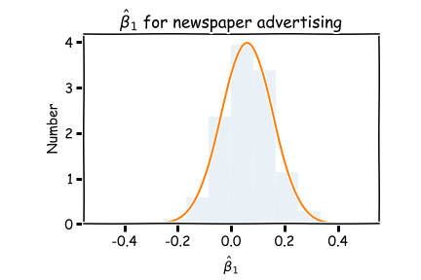
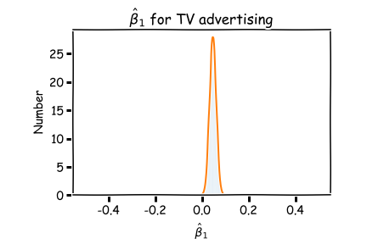
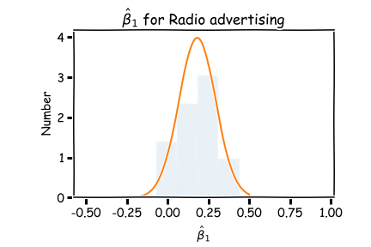
And also we can answer the question, ’how significant are the predictors?’ Here we show the same analysis for all three predictors.
Question: Which ones are important?
Before we answer this question, we need to answer another question.

Slide 48
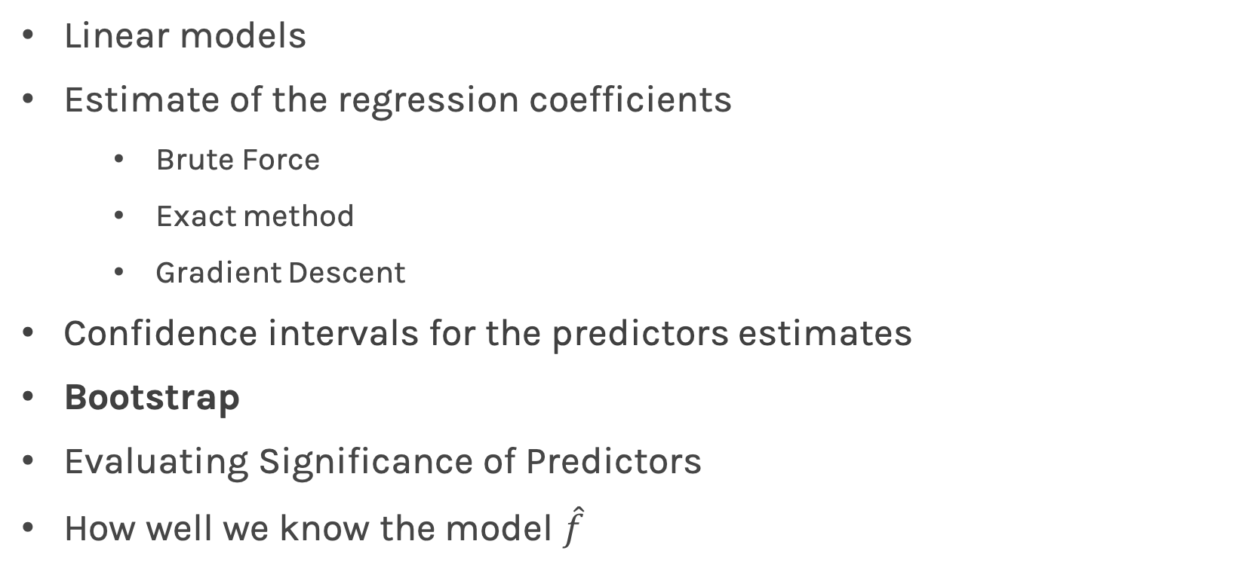
Lecture Outline
Linear models
Estimate of the regression coefficients
Brute Force
Exact method
Gradient Descent
Confidence intervals for the predictors estimates
Bootstrap
Evaluating Significance of Predictors
How well we know the model $\hat{f}$

Slide 49
Bootstrap
In the lack of active imagination, parallel universes and the likes, we need an alternative way of producing fake data set that resemble the parallel universes.
.
Bootstrapping is the practice of sampling from the observed data (X,Y) in estimating statistical properties.

Slide 50
Bootstrap
Imagine we have 5 billiard balls in a bucket.

Slide 51
Bootstrap
We first pick randomly a ball and replicate it. This is called sampling with replacement.
We move the replicated ball to another bucket.

Slide 52
Bootstrap

Slide 53
Bootstrap
We then randomly pick another ball and again we replicate it.
As before, we move the replicated ball to the other bucket.

Slide 54
Bootstrap

Slide 55
Bootstrap
We repeat this process.
Notes:
Fix this with true replacement

Slide 56
Bootstrap
Again

Slide 57
Bootstrap
And again

Slide 58
Bootstrap
Until the “other” bucket has the same number of balls as the original one.
This new bucket represents a new parallel universe

Slide 59
Bootstrap
We repeat the same process and acquire another sample.

Slide 60
Bootstrap
We repeat the same process and acquire another sample.
These new buckets represents the parallel universes

Slide 61
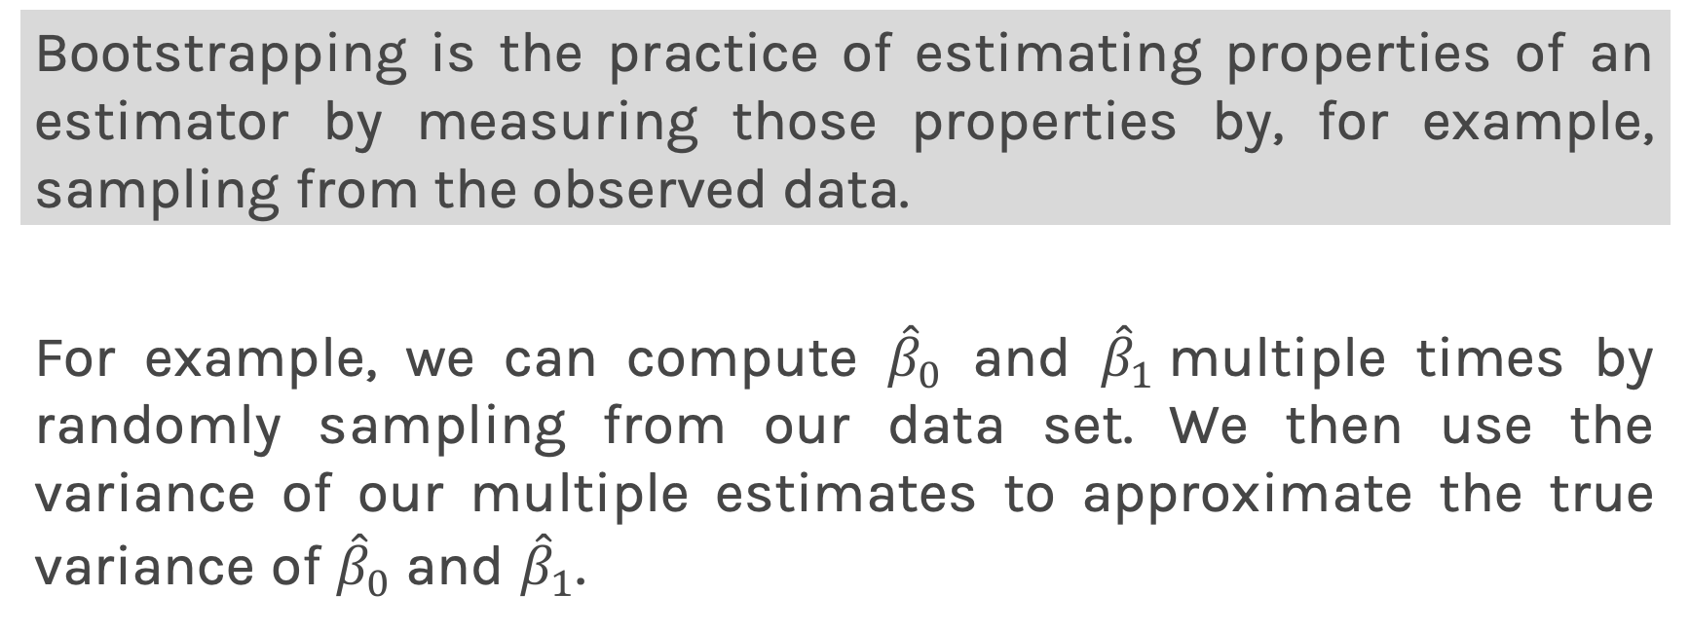
Bootstrapping for Estimating Sampling Error
Definition
Bootstrapping is the practice of estimating properties of an estimator by measuring those properties by, for example, sampling from the observed data.
For example, we can compute ${\hat{β}}_{0}$ and ${\hat{β}}_{1}$multiple times by randomly sampling from our data set. We then use the variance of our multiple estimates to approximate the true variance of ${\hat{β}}_{0}$ and ${\hat{β}}_{1}$.

Slide 62
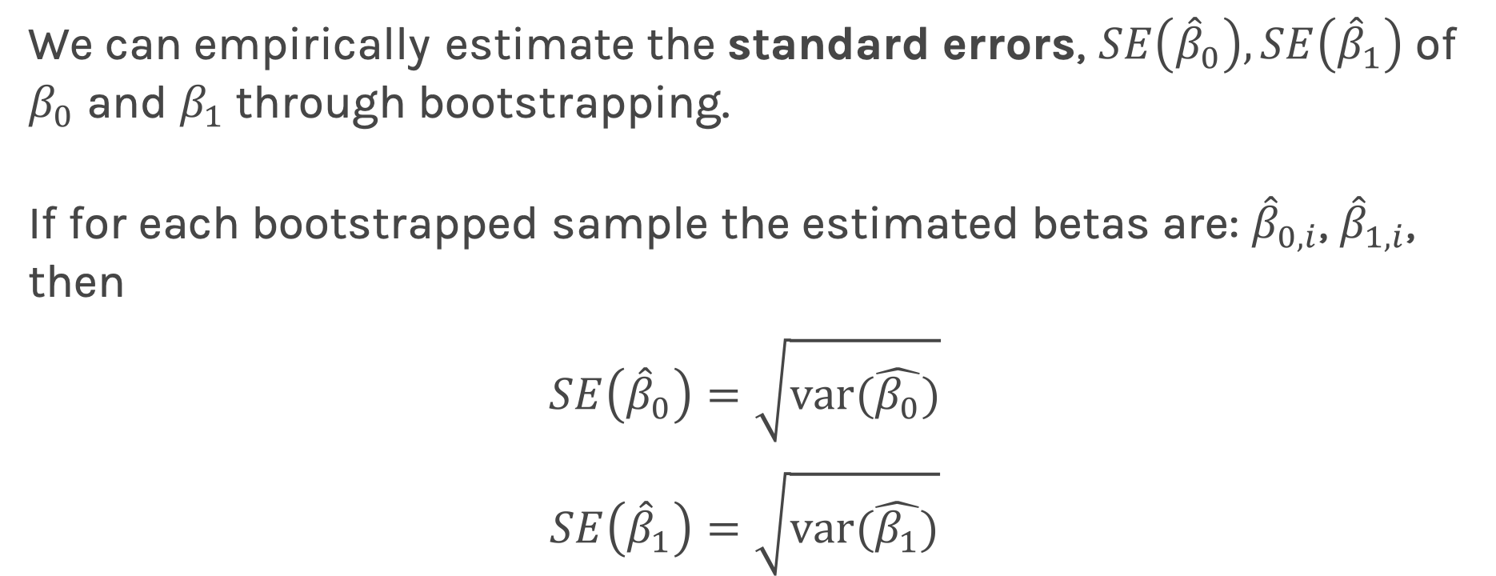
Confidence intervals for the predictors estimates: Standard Errors
We can empirically estimate the standard errors, $SE\left({\hat{β}}_{0}\right),SE\left({\hat{β}}_{1}\right)$ of $β_{0}$ and $β_{1}$through bootstrapping.
If for each bootstrapped sample the estimated betas are: ${\hat{β}}_{0,i}$, ${\hat{β}}_{1,i}$, then
$$SE\left({\hat{β}}_{0}\right)=\sqrt{var(\hat{β_{0}})}$$
$$SE\left({\hat{β}}_{1}\right)=\sqrt{var(\hat{β_{1}})}$$
Notes:
If data set is small this approximation does not work

Slide 63
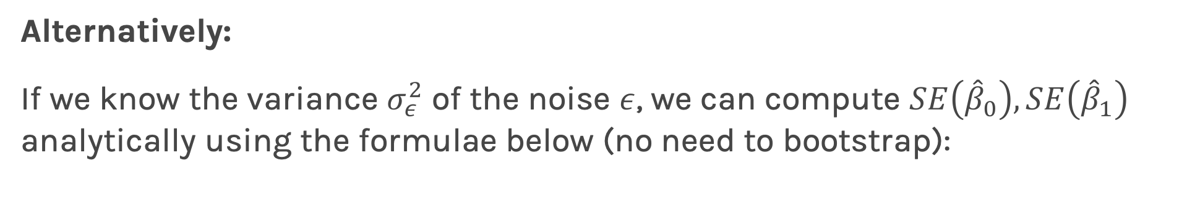
Confidence intervals for the predictors estimates: Standard Errors
Alternatively:
If we know the variance $σ_{ε}^{2}$ of the noise $ε$, we can compute $SE\left({\hat{β}}_{0}\right),SE\left({\hat{β}}_{1}\right)$ analytically using the formulae below (no need to bootstrap):
Notes:
If data set is small this approximation does not work

Slide 64


Standard Errors
More data: $n↑$ and $\sum_{i}{({x_{i}−\overline{x})}^{2}}↑⟹SE↓$
Larger coverage: $var(x)$ or $\sum_{i}{({x_{i}−\overline{x})}^{2}}↑ ⟹$ $SE↓$
Better data: $σ^{2}↓ ⇒SE↓$
In practice, we do not know the theoretical value of $σ$ since we do not know the exact distribution of the noise $ε$.
Notes:
If data set is small this approximation does not work.
If the var(x) goes up (meaning that the data becomes more spread out) then your confidence intervals go up.
Number of points, quality of the data, and spread of the data, all contribute to the standard error.

Slide 65


Standard Errors
However, if we make the following assumptions,
the errors $ε_{i}=y_{i}−{\hat{y}}_{i}$and $ε_{j}=y_{j}−{\hat{y}}_{j}$ are uncorrelated, for $i≠j$ ,
each $ε_{i}$ has a mean 0 and variance $σ_{ε}^{2}$,
then, we can empirically estimate $σ^{2}$, from the data and our regression line:
Remember:
$$y_{i}=f\left(x_{i}\right)+ε_{i}⟹ε_{i}=y_{i}−f(x_{i})$$

Slide 66

Standard Errors
More data: $n↑$ and $\sum_{i}{({x_{i}−\overline{x})}^{2}}↑⟹SE↓$
Larger coverage: $var(x)$ or $\sum_{i}{({x_{i}−\overline{x})}^{2}}↑ ⟹$ $SE↓$
Better data: $σ^{2}↓ ⇒SE↓$
Better model: $(\hat{f}−y_{i}) ↓$ $⟹σ↓ ⟹SE↓$
Question: What happens to the $\hat{β_{0}}$, $\hat{β_{1}}$ under these scenarios?

Slide 67

Standard Errors
The following results are for the coefficients for TV advertising:
Method | $$SE\left({\hat{β}}_{1}\right)$$
Analytic Formula | 0.0061
Bootstrap | 0.0061
The coefficients for TV advertising but restricting the coverage of x are:
The coefficients for TV advertising but with added extra noise:
Method | $$SE\left({\hat{β}}_{1}\right)$$
Analytic Formula | 0.0068
Bootstrap | 0.0068
This makes no sense?
Method | $$SE\left({\hat{β}}_{1}\right)$$
Analytic Formula | 0.0028
Bootstrap | 0.0023

Slide 68

Standard Errors
Exercise: Duplicate the following results for the coefficients for TV advertising.
Method | $$SE\left({\hat{β}}_{0}\right)$$ | $$SE\left({\hat{β}}_{1}\right)$$
Analytic Formula | 0.353 | 0.0028
Bootstrap | 0.328 | 0.0023

Slide 69

Lecture Outline
Linear models
Estimate of the regression coefficients
Brute Force
Exact method
Gradient Descent
Confidence intervals for the predictors estimates
Bootstrap
Evaluating Significance of Predictors
Hypothesis Testing
How well we know the model $\hat{f}$

Slide 70
Interpretation of Predictors
Question: What do you think a predictor coefficient means?
$$Sales=7.5+0.04 TV$$
What does 7.5 mean and what does 0.04 mean?
If we increase the TV by $1000, what would you expect the increase in sales to be?
What if? $Sales=7.5+1.01 TV$
The interpretation of the predictors depends on the values but decisions depend on how much we trust these values.
Notes:
Axes labels! (DLS)

Slide 71
And also we can answer the question, ’how significant are the predictors?’ Here we show the same analysis for all three predictors.
Question: Which ones are important?
Before we answer this question, we need to answer another question.

Slide 72
And also we can answer the question, ’how significant are the predictors?’ Here we show the same analysis for all three predictors.
Question: Which ones are important?
Now we know how to generate these distributions we are ready to answer ’how significant are the predictors?’

Slide 73
Hypothesis Testing
Hypothesis testing is a formal process through which we evaluate the validity of a statistical hypothesis by considering evidence for or against the hypothesis gathered by random sampling of the data.

Slide 74






TV | sales
68.4 | 22.1
202.5 | 10.4
248.8 | 9.3
191.1 | 18.5
23.8 | 12.9
296.4 | 7.2
26.8 | 11.8
164.5 | 13.2
209.6 | 4.8
147.3 | 10.6
139.2 | 8.6
109.8 | 17.4
43.0 | 9.2
73.4 | 9.7
262.7 | 19.0
28.6 | 22.4
135.2 | 12.5
240.1 | 24.4
Random sampling of the data
Shuffle the values of the predictor variable
TV | sales
50.0 | 22.1
184.9 | 10.4
11.7 | 9.3
219.8 | 18.5
13.1 | 12.9
248.8 | 7.2
76.4 | 11.8
197.6 | 13.2
195.4 | 4.8
75.5 | 10.6
238.2 | 8.6
222.4 | 17.4
171.3 | 9.2
184.9 | 9.7
193.2 | 19.0
131.7 | 22.4
116.0 | 12.5
166.8 | 24.4
TV | sales
88.3 | 22.1
102.7 | 10.4
204.1 | 9.3
39.5 | 18.5
68.4 | 12.9
59.6 | 7.2
70.6 | 11.8
265.2 | 13.2
292.9 | 4.8
76.4 | 10.6
80.2 | 8.6
182.6 | 17.4
112.9 | 9.2
199.1 | 9.7
147.3 | 19.0
89.7 | 22.4
225.8 | 12.5
193.2 | 24.4
TV | sales
215.4 | 22.1
89.7 | 10.4
68.4 | 9.3
75.3 | 18.5
142.9 | 12.9
220.3 | 7.2
255.4 | 11.8
139.5 | 13.2
237.4 | 4.8
16.9 | 10.6
13.1 | 8.6
218.5 | 17.4
147.3 | 9.2
25.6 | 9.7
216.4 | 19.0
238.2 | 22.4
213.4 | 12.5
109.8 | 24.4
TV | sales
216.4 | 22.1
276.7 | 10.4
23.8 | 9.3
13.2 | 18.5
26.8 | 12.9
170.2 | 7.2
0.7 | 11.8
87.2 | 13.2
120.5 | 4.8
293.6 | 10.6
78.2 | 8.6
43.0 | 17.4
139.2 | 9.2
276.9 | 9.7
239.3 | 19.0
191.1 | 22.4
25.1 | 12.5
25.6 | 24.4
TV | sales
230.1 | 22.1
44.5 | 10.4
17.2 | 9.3
151.5 | 18.5
180.8 | 12.9
8.7 | 7.2
57.5 | 11.8
120.2 | 13.2
8.6 | 4.8
199.8 | 10.6
66.1 | 8.6
214.7 | 17.4
23.8 | 9.2
97.5 | 9.7
204.1 | 19.0
195.4 | 22.4
67.8 | 12.5
281.4 | 24.4

Slide 75




Slide 76





$$μ_{Null}=0$$
$$μ_{\hat{β}}=μ_{boot}$$
$$σ_{\hat{β}}=SE\left(\hat{β}\right)=σ_{boot}$$
$$σ_{Null}≈σ_{\hat{β}}$$
Translate this to the significance. Let’s look at the distance of the estimated value of the coefficient in units of SE(${\hat{β}}_{1}$) = $σ_{{\hat{β}}_{1}}$.
$D=\frac{{ μ}_{\hat{β}}−μ_{Null}}{\sqrt{σ_{Null}^{2}+σ_{\hat{β} }^{2}}}=\frac{{ μ}_{\hat{β}}}{\sqrt{σ_{Null}^{2}+σ_{\hat{β} }^{2}}}$ = $\frac{{ μ}_{\hat{β}}}{\sqrt{2}σ_{\hat{β}}}$

Slide 77




Importance of predictors
In practice, we do not need the distribution for Null.
Define a test statistic, which we we call t-test statistic
Which measures the distance from zero in units of
standard deviation.
We evaluate how often a particular value of t can occur by accident. We expect that t will have a t-distribution with n-2 degrees of freedom.
To compute the probability of observing any value equal to $|t|$ or larger, assuming ${\hat{β}}_{1}=0$ is easy. We call this probability the p-value.
a small p-value (<0.05) indicates that it is unlikely to observe such a substantial association between the predictor and the response due to chance.
$$μ_{{\hat{β}}_{1}}−0$$
$$σ_{{\hat{β}}_{1}}$$
$$t=\frac{μ_{{\hat{β}}_{1}}}{σ_{{\hat{β}}_{1}}}$$
Notes:
FIX THIS

Slide 78

Hypothesis Testing
Hypothesis testing is a formal process through which we evaluate the validity of a statistical hypothesis by considering evidence for or against the hypothesis gathered by random sampling of the data.
State the hypotheses, typically a null hypothesis, $H_{0}$ and an alternative hypothesis, $H_{1}$, that is the negation of the former.
Choose a type of analysis, i.e. how to use sample data to evaluate the null hypothesis. Typically this involves choosing a single test statistic.
Sample data and compute the test statistic.
Use the value of the test statistic to either reject or not reject the null hypothesis.

Slide 79


Hypothesis testing
1. State Hypothesis:
Null hypothesis:
$H_{0}$: There is no relation between X and Y
The alternative:
$H_{a}$: There is some relation between X and Y
2: Choose test statistics
To test the null hypothesis, we need to determine whether, our estimate for ${\hat{β}}_{1}$, is sufficiently far from zero that we can be confident that ${\hat{β}}_{1}$ is non-zero. We use the following test statistic:
$$t=\frac{μ_{{\hat{β}}_{1}}}{σ_{{\hat{β}}_{1}}}$$

Slide 80

Hypothesis testing
3. Sample:
Using bootstrap we can estimate ${\hat{β}}_{1}^{′}s$, and therefore $μ_{{\hat{β}}_{1}}$and $σ_{{\hat{β}}_{1}}.$
4. Reject or not reject the hypothesis:
If there is really no relationship between X and Y , then we expect that will have a t-distribution with n-2 degrees of freedom.
To compute the probability of observing any value equal to $|t|$ or larger, assuming ${\hat{β}}_{1}=0$ is easy. We call this probability the p-value.
a small p-value indicates that it is unlikely to observe such a substantial association between the predictor and the response due to chance

Slide 81

Lecture Outline
Linear models
Estimate of the regression coefficients
Brute Force
Exact method
Gradient Descent
Confidence intervals for the predictors estimates
Bootstrap
Evaluating Significance of Predictors
Hypothesis Testing
How well we know the model $\hat{f}$

Slide 82


How well do we know $\hat{f}$?
Our confidence in $f$ is directly connected with the confidence in $β$s. So for each bootstrap sample, we have one $β$ which we can use to determine the model.

Slide 83

How well do we know $\hat{f}$?
Here we show two difference set of models given the fitted coefficients.

Slide 84

How well do we know $\hat{f}$?
There is one such regression line for every bootstrapped sample.

Slide 85


How well do we know $\hat{f}$?
Below we show all regression lines for a thousand of such bootstrapped samples.
For a given $x$, we examine the distribution of $\hat{f}$, and determine the mean and standard deviation.

Slide 86

How well do we know $\hat{f}$?
Below we show all regression lines for a thousand of such sub-samples.
For a given $x$, we examine the distribution of $\hat{f}$, and determine the mean and standard deviation.

Slide 87

How well do we know $\hat{f}$?
Below we show all regression lines for a thousand of such sub-samples.
For a given $x$, we examine the distribution of $\hat{f}$, and determine the mean and standard deviation.

Slide 88


How well do we know $\hat{f}$?
For every $x$, we calculate the mean of the models, $\hat{f}$ (shown with dotted line) and the 95% CI of those models (shaded area).
Estimated $\hat{f}$

Slide 89

Confidence in predicting $\hat{y}$

Slide 90


Confidence in predicting $\hat{y}$
for a given x, we have a distribution of models $f\left(x\right)$
for each of these $f\left(x\right),$the prediction for $y\sim N(f, σ_{ε})$

Slide 91


Confidence in predicting $\hat{y}$
for a given x, we have a distribution of models $f\left(x\right)$
for each of these $f\left(x\right),$the prediction for $y\sim N\left(f, σ_{ε}\right)$
The prediction confidence intervals are then

Slide 92

Summary
Linear models
Estimate of the regression coefficients
Brute Force
Exact method
Gradient Descent
Confidence intervals for the predictors estimates
Bootstrap
Evaluating Significance of Predictors
Hypothesis Testing
How well we know the model $\hat{f}$

Slide 93

Summary so far
Model Fitness
How does the model perform predicting?
Comparison of Two Models
How do we choose from two different models?
Evaluating Significance of Predictors
Does the outcome depend on the predictors?
How well do we know $\hat{f}$
The confidence intervals of our $\hat{f}$

Slide 94
What’s next?
Multiple predictors
Collinearity
Categorical variables
Polynomial regression
Interaction terms

Slide 95
Afternoon Exercises
Quiz - to be completed in the next 10 min:
Sway: Lecture 5: Linear Regression
Programmatic – to be completed by lab time tomorrow:
Lessons: Lecture 5: Linear Regression – three (3) exercises

